Slide 1
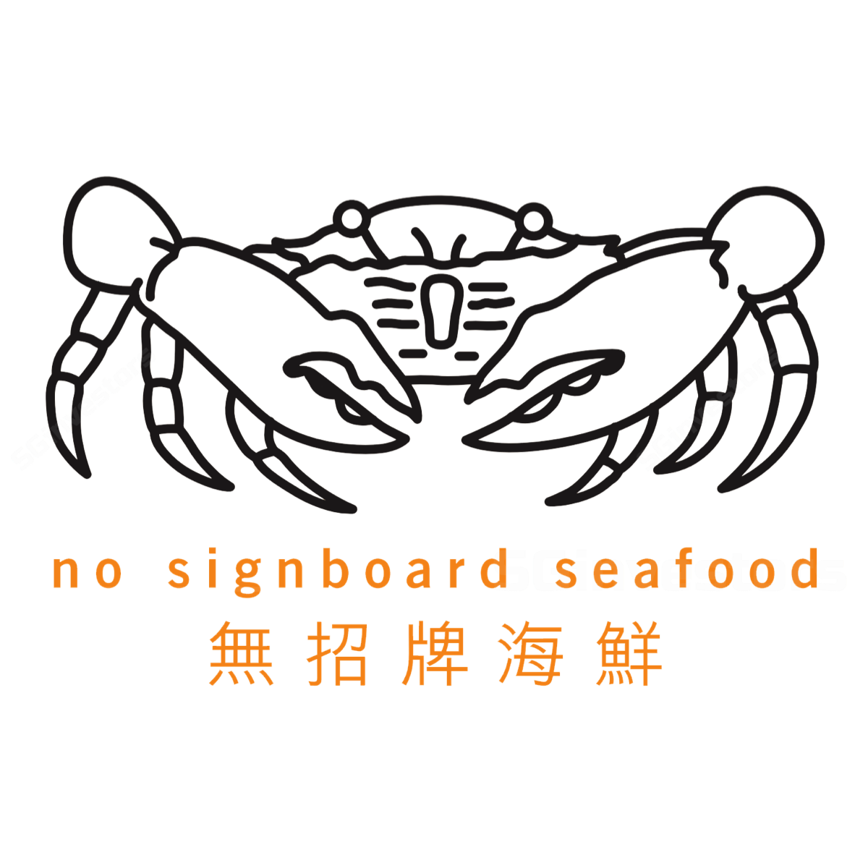
Business Aperture
No Signboard Holdings Ltd
Exchange: SGX
Consumer Discretionary / Consumer Services / Hotels, Restaurants and Leisure
Ticker: SGX1G6
Advise:
“Don’t get caught by the pincers “
Date : 2nd of July 2019

Slide 2
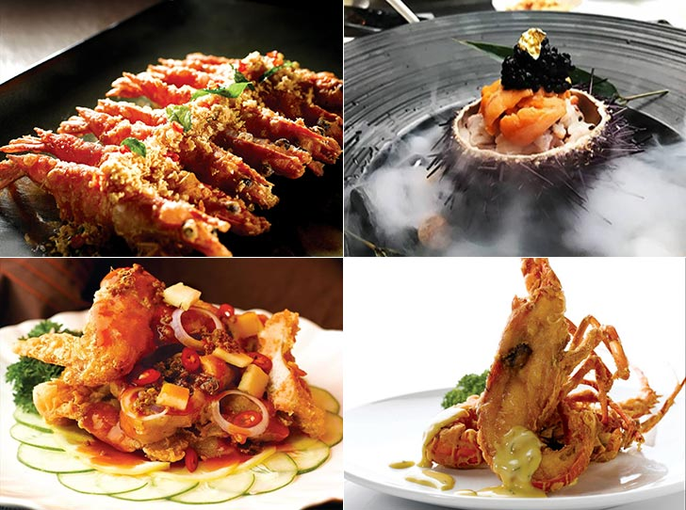
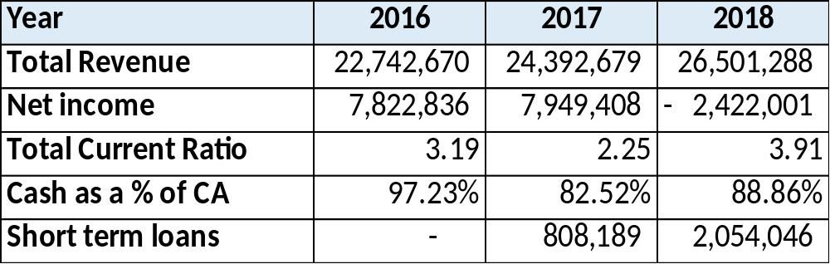
Company Overview
Business Aperture
Background
Founded in 1981, No Signboard Holdings is a food and beverage company located in Singapore. They operate restaurants and own a beer businesses. Their main business is operating a chain of seafood restaurants under the No Signboard Seafood brand, where they are known for their signature White Pepper Crab. They successfully listed on the Catalist of the SGX on the November 2017. In the November of 2018, they were Awarded Top Brand for Seafood Restaurant category 2018 by Influential Brands.
Key Financial Information

Slide 3
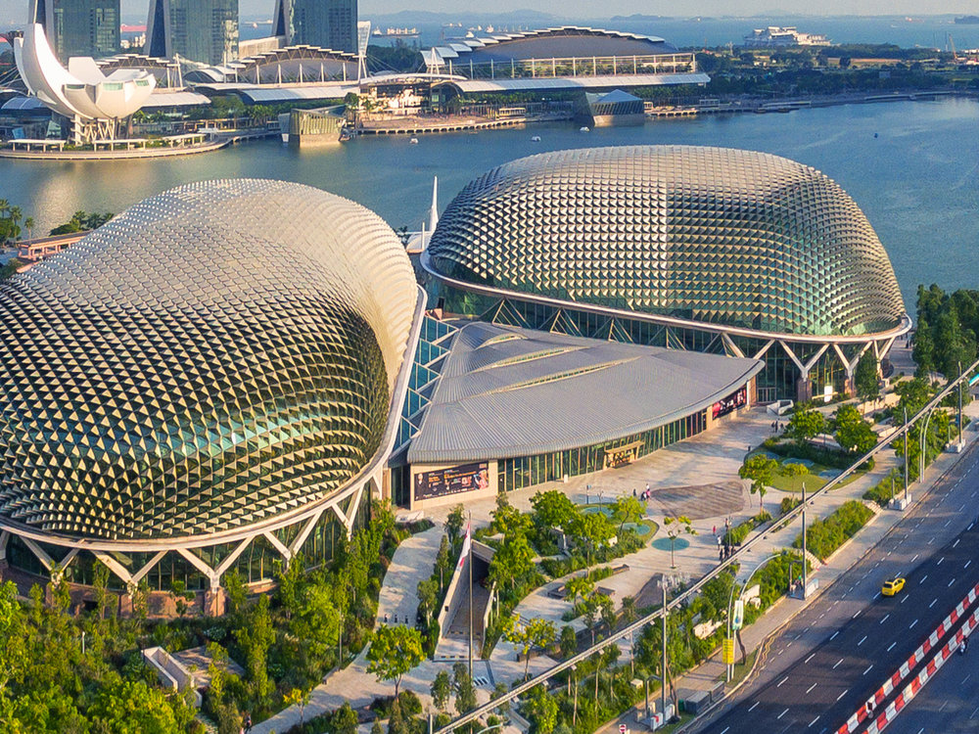
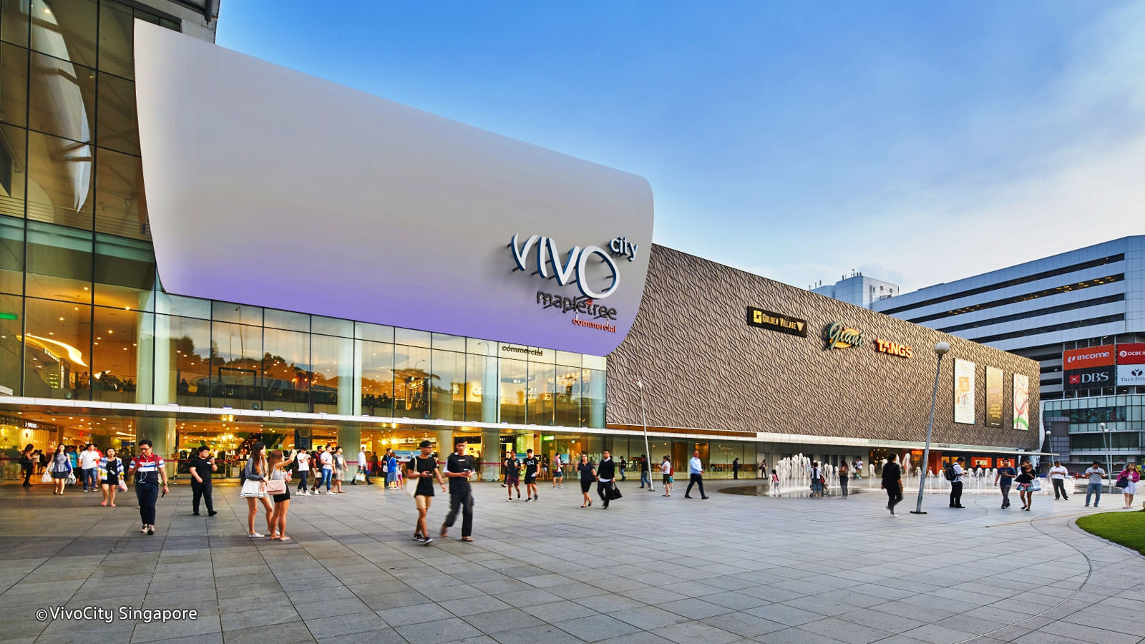
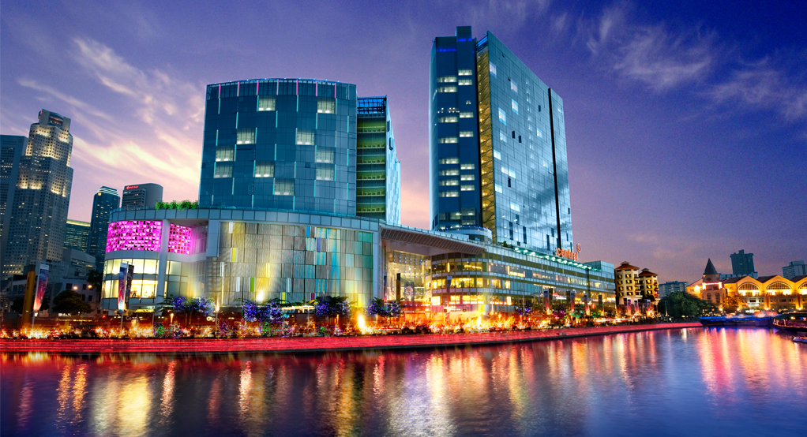
Businesses – No Signboard Seafood
Business Aperture
No Signboard Seafood
No Signboard Seafood operates 3 seafood focused restaurants. These malls are located within major shopping belts and tourist attractions. Esplanade is a performing arts center with a large concert hall located near the Singapore river. Vivo City is currently the largest shopping mall in Singapore. Clarke Quay is known as the hub for Singapore nightlife with many bars and nightclubs. All locations have an MRT station located within walking distance. The group also has one restaurant under franchise agreement located in Geylang (where they earn a fixed fee yearly).
Esplanade (South)
Opened in 2004
VivoCity (South)
Opened in 2006
The Central @ Clarke Quay (Central)
Opened in 2009

Slide 4
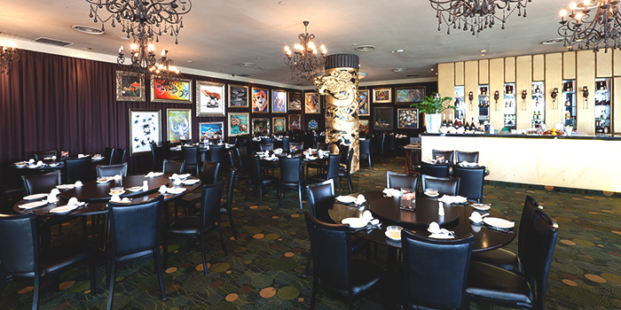
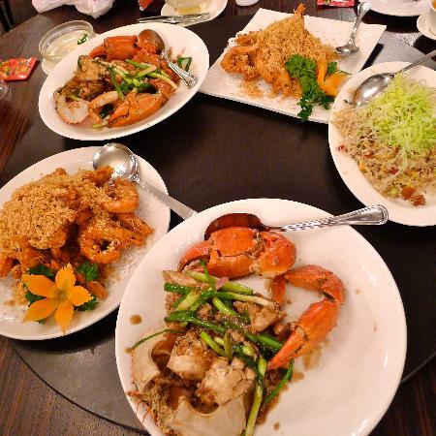
Businesses – No Signboard Seafood
Business Aperture
No Signboard Seafood
At No Signboard Seafood, Customers usually dine in a big group where they share an array of dishes. It is normal for locals to go with their families. The restaurant is famous amongst locals for serving quality seafood dishes. As it is on more expensive than non-seafood restaurants, it is common to go only on special occasions and celebrations. It is also a highly recommended place for tourists looking to try quality Asian seafood, making it a favourite amongst travellers.
Based on online estimates, the average expenditure per person is between $50-$60 and can go as high as $100 per person. Vegetables and meat dishes cost between $20-$30. Seafood dishes cost between $30-$50 while their signature premium dishes costs around $100.
Large tables to accommodate huge groups
Wide array of dishes for sharing
https://www.hungrygowhere.com/singapore/no_signboard_seafood_restaurant_geylang/

Slide 5
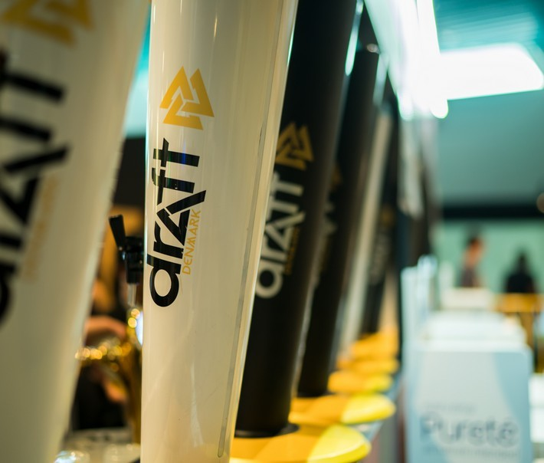

Businesses
Business Aperture
Beer Distribution Business
No Signboard Holdings owns 100% of Danish Breweries, which owns its signature Draft Denmark brand. It is distributed across 150 outlets in Singapore compromising of pubs, coffee shops and clubs. The group is undergoing a full restructuring plan for their Beer Business. This is to initiate positive changes for the Beer business.
Steps taken:
1) Appointment of a New Executive Vice President, Mr Arthur Quek, with more than 20 years of experience in the beer industry, to manage and lead the Beer Business
2) Rebranding Exercise includes changing the design of its beer bottles to provide a new and refreshing look.
3) Increase product mix and SKU offerings. The new SKU – canned beer, will allow the Beer Business to penetrate into the minimarts and supermarkets, expanding target markets.
4) Plans to enhance distribution channels by distributing Draft Denmark beer to more coffeeshops to increase brand visibility across larger demographics
5) Replaced one of its brewing facilities to address quality issues with its bottled beer.
6) Review all aspects of costs and vendors to improve its cost structure, logistics and production process efficiency.

Slide 6
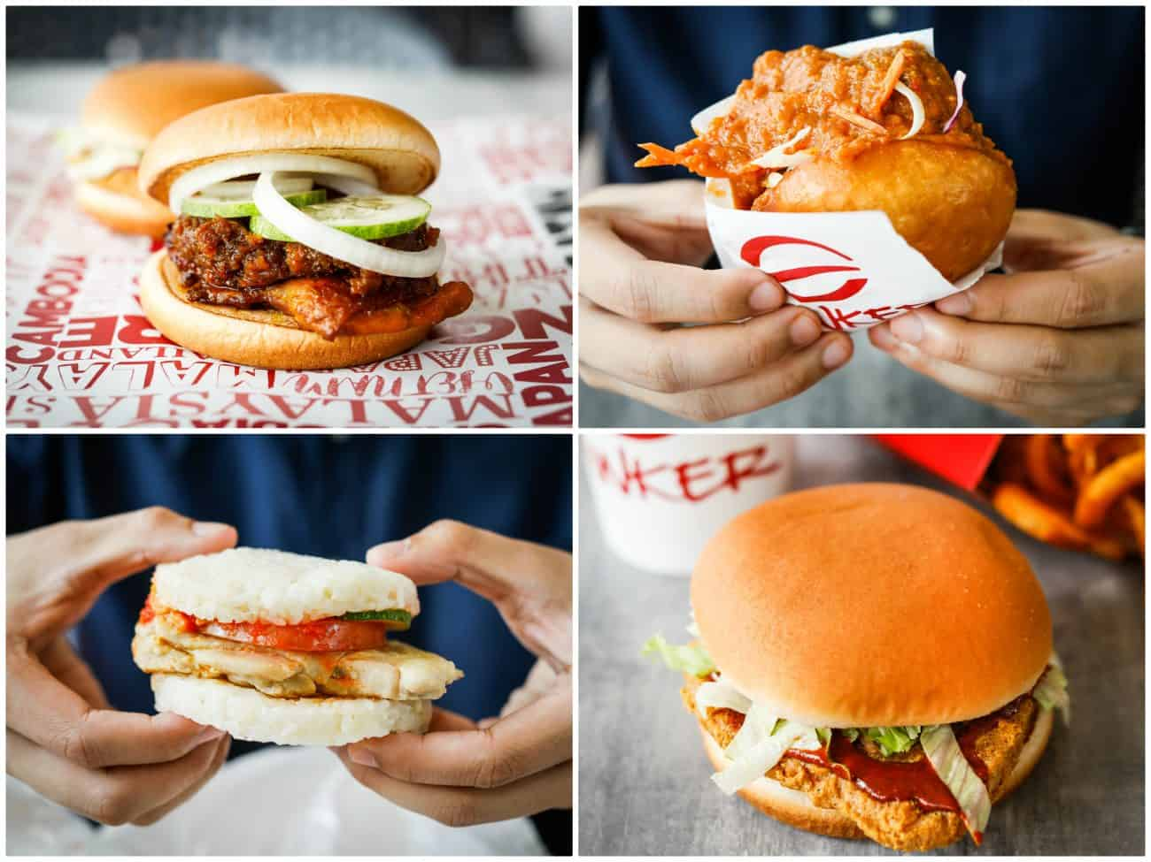
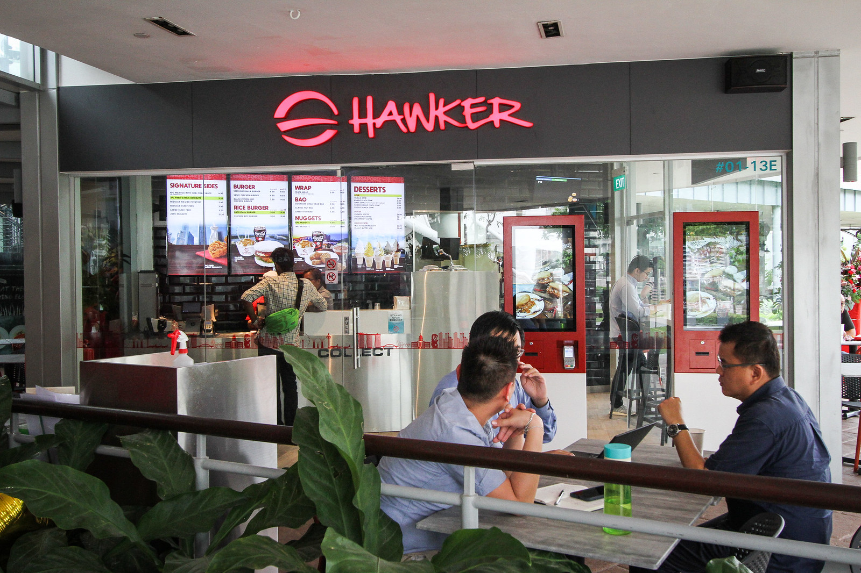
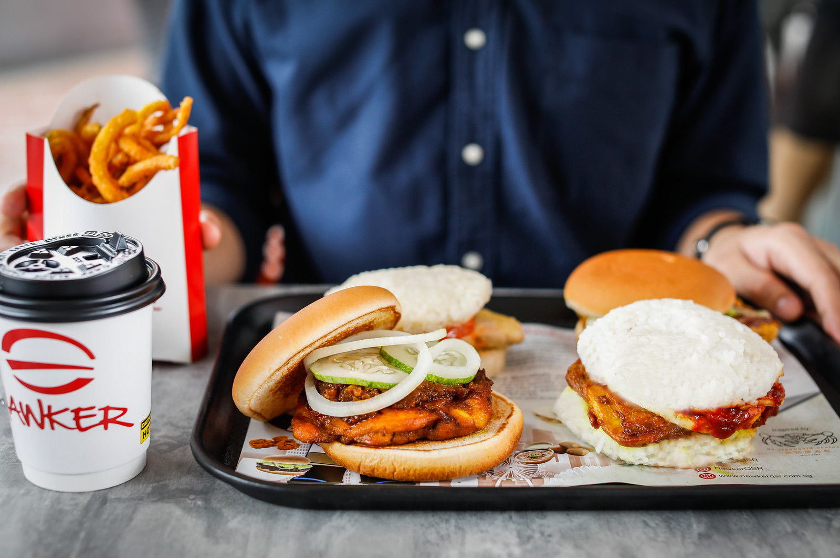
Businesses
Business Aperture
Quick Service Restaurants
In 2018, the Group moved into quick service (fast food) restaurants (“QSR”).
This is in line with their long-term strategy of diversifying their restaurant portfolio.
1) Asian focused
Fast Food:
“ Hawker”
This fast food restaurant offers hawker themed burgers, wraps and buns. Providing an Asian twist to common western foods. Examples include their Chilli Crab Bao and their Satay Chicken Burger. They currently have 3 Outlets @ Esplanade, Kent Ridge Center and Jewel. It has plans to open another at Paya Lebar Quarter in 2019.

Slide 7
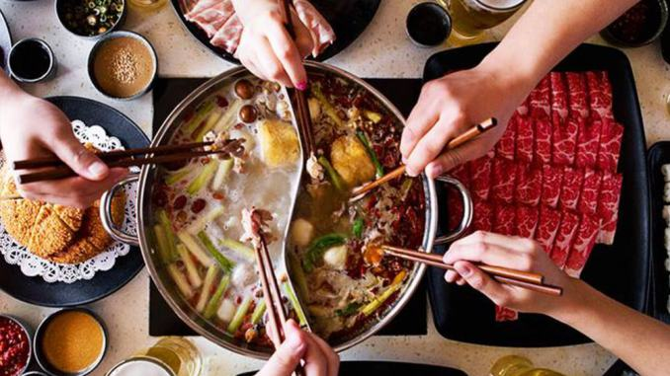
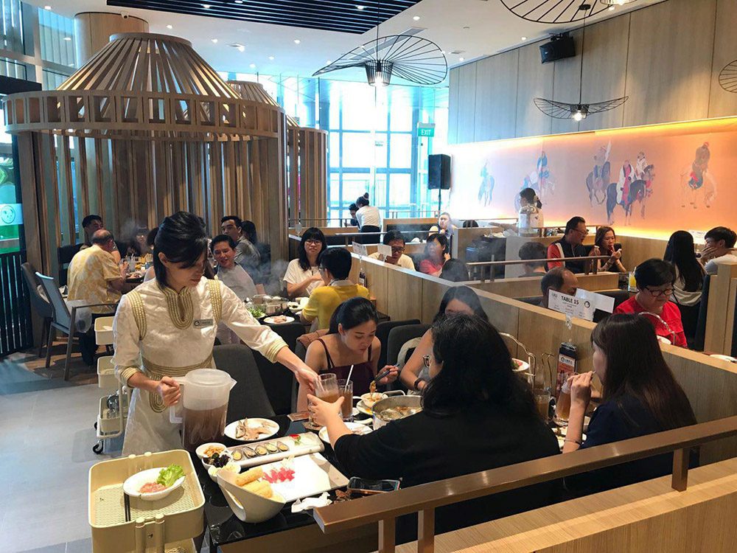
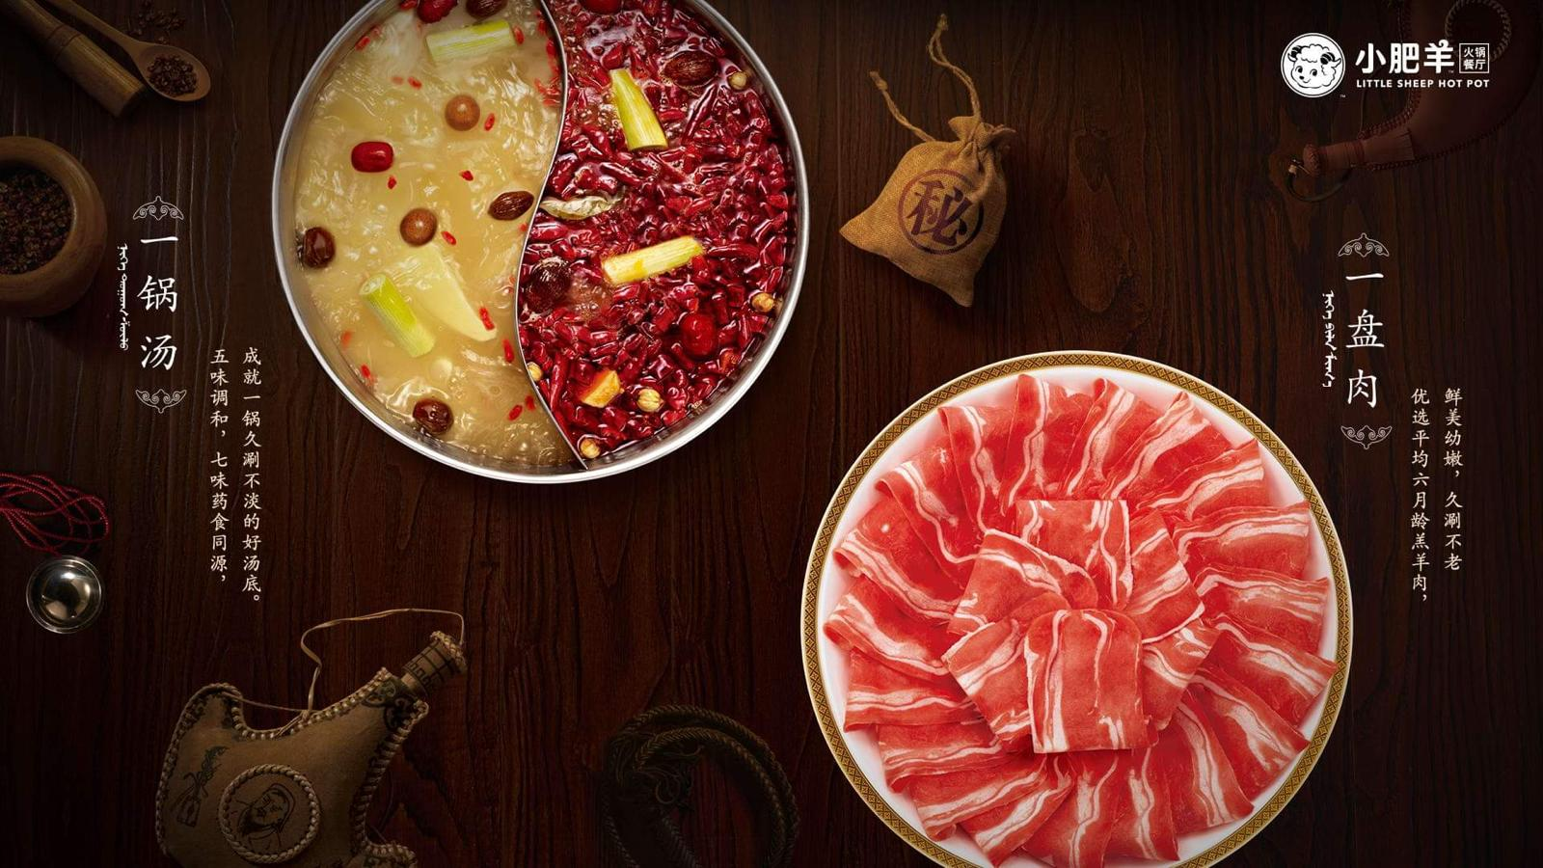
Businesses
Business Aperture
2) Hot pot restaurant :“Little Sheep Hotpot”
Originating from Mongolia before its meteoric rise in Greater China, Little Sheep Hotpot is well known for its steaming aromatic soup broth of five flavours, infused with medicinal herbs and food spice ingredients. The Little Sheep Group is owned by Yum China and it has 300 chain restaurants in China, Japan, Canada and the United States. Little Sheep Group was once listed on the Hong Kong Stock Exchange but has been delisted.
No Signboard Holdings signed a franchise agreement with Little Sheep Group in June 2018. Under the agreement No Signboard holdings needs to develop at least one restaurant per year for the next five years. The group has opened one in December 2018. at the One Fullerton. a premier shopping mall located near the Central Business District and the Singapore River. Customers are expected to spend between $30-$50 a person.
https://www.straitstimes.com/lifestyle/food/famous-hotpot-chain-little-sheep-to-open-in-singapore-under-no-signboard-holdings

Slide 8
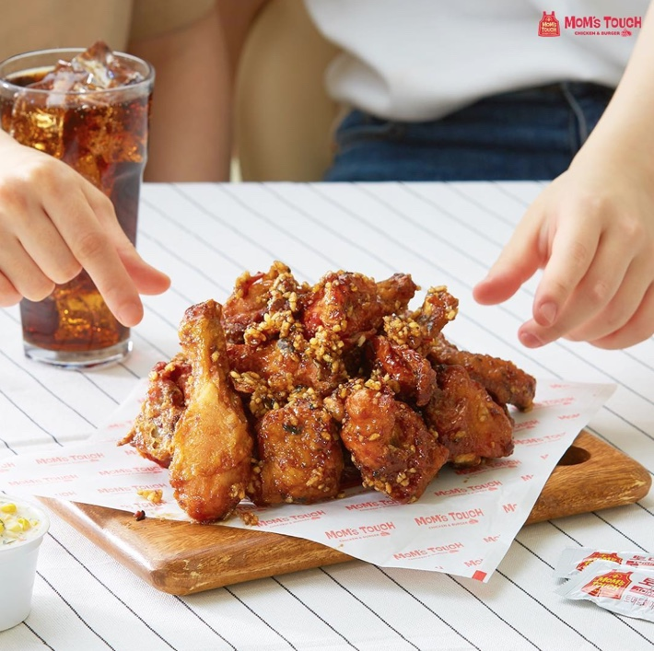
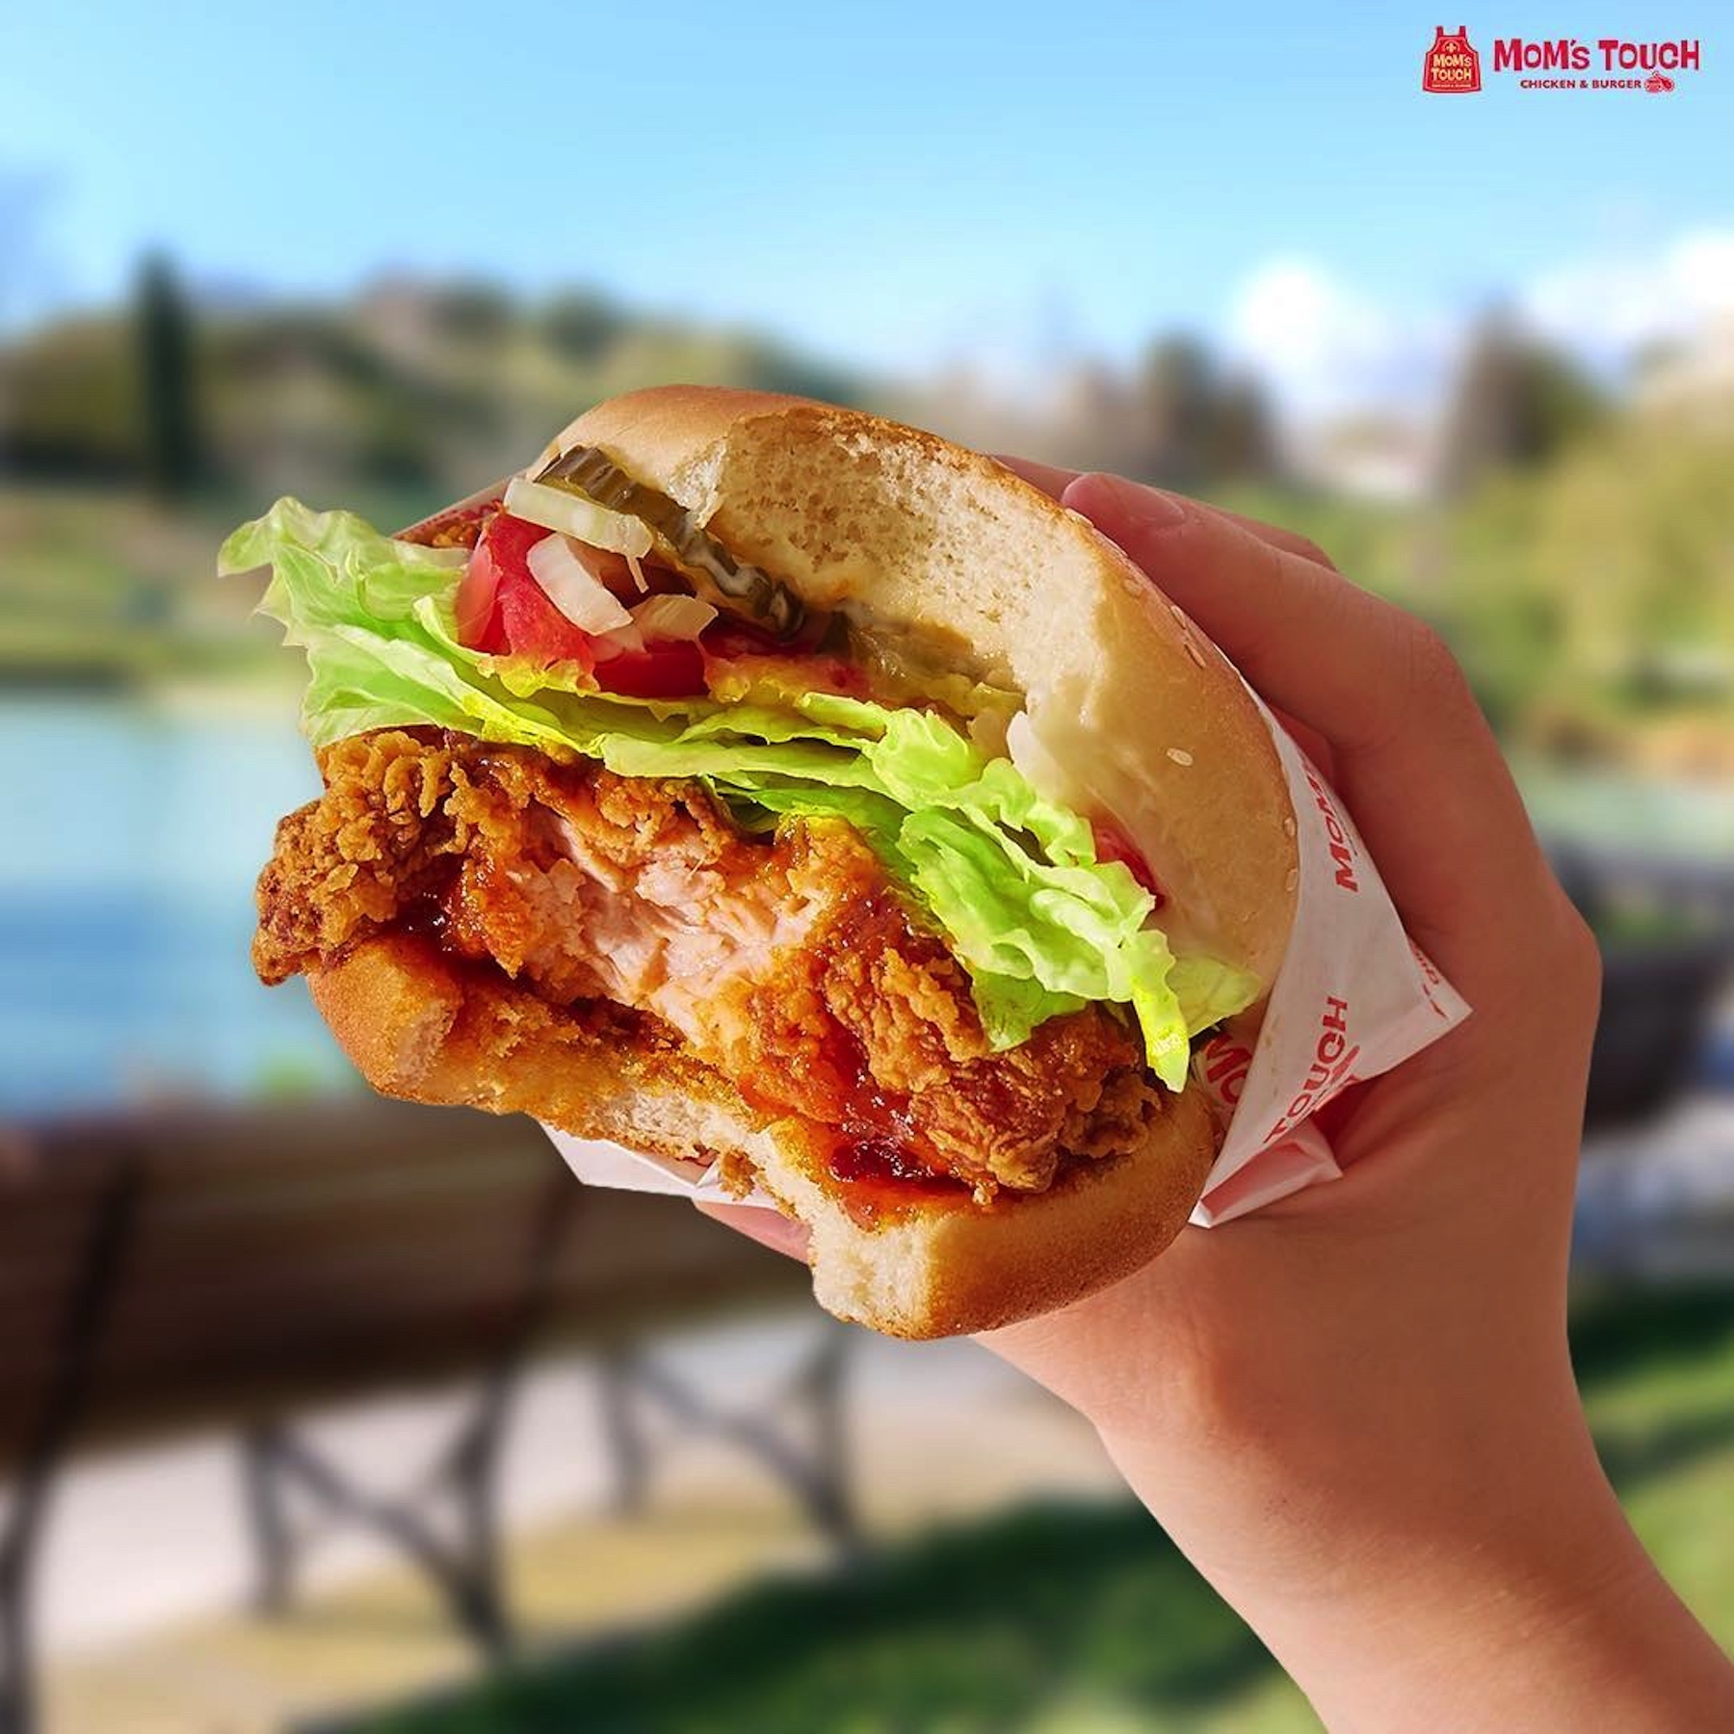
Businesses
Business Aperture
3) Gourmet Fried Korean chicken: “Mom’s Touch”
In October 2018, the group entered an exclusive master franchise agreement to expand Mom’s Touch into Singapore and Malaysia. Mom’s Touch is a famous Korean fried chicken and burger chain.
Korean fried chicken are known to be glazed with sauces after frying. Unlike KFC, the dishes are made to order and are hence refrigerated and not frozen. They also use a vacuum tumbler method instead of general method and features deep taste and soft meat quality.
Mom’s Touch has over 1300 stores in Korea and some in Taiwan (5), Vietnam (2) and California. Mom’s Touch is currently owned by Haimarrow, a food and goods production and distribution company, as well as an F&B franchise business. The agreement is for 10 years with an option to renew for another 10 years. It has plans to open 1 in Singapore and Malaysia within 2019 with a total of 7 over the next 3 years.
http://www.koreaherald.com/view.php?ud=20180104000823

Slide 9
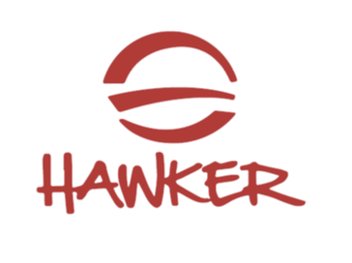
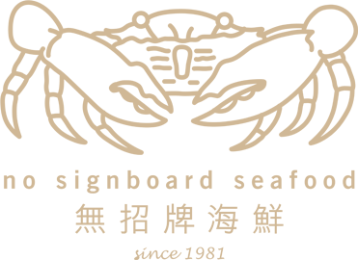

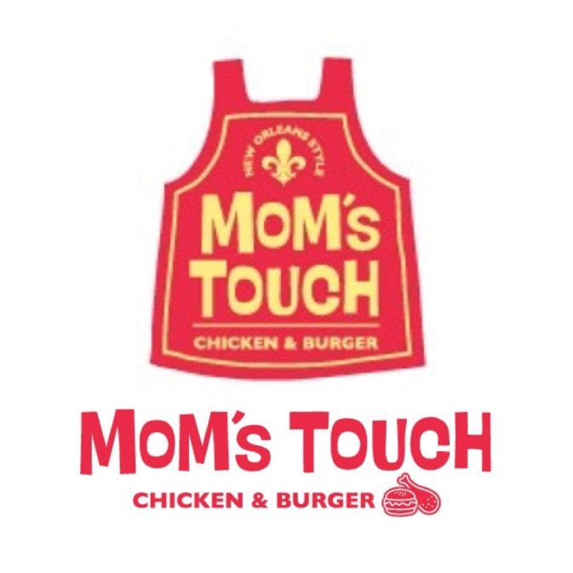

Corporate Structure
Business Aperture
Singapore Chilli Crab pte ltd
NSB-IP Holdings Ltd
(Holds all IP and trademarks)
NSB-Central Kitchen Ltd
(Operates Central Kitchen)
Hawker QSR pte ltd
Draft Beer pte ltd
NSB Restaurants pte ltd
(Operates New Restaurant Concepts)
No Signboard Holdings Ltd.
(Operates Restaurant Business)
Tao Brewery Ltd
(Operates Beer Business)
NSB-Crab factory pte ltd
NSB Global Franchise Management pte ltd
(Operates Franchise Brands)
Danish Breweries pte ltd
NSB-Crab factory (china) pte ltd
NSB Franchise pte ltd
NSB-Mom’s Touch pte ltd
NSB Hotpot pte ltd

Slide 10
Others
Business Aperture
Expansion Plans
Added Sources of Concern
As part of its overseas growth and expansion strategies, NSB has also identified premises for its new casual dining concept in China and is in the final stages of the lease negotiation. Upon successful negotiation of the lease, the new restaurant is targeted to debut in China by middle of 2019, marking the Group’s first step out of its home ground, after more than 30 years, to materialise its overseas expansion plan.
On February 1, it reported a net loss of S$574k for the first quarter ended Dec 31, 2018, from a restated loss of S$416k a year ago for the same quarter. What passed without any proper explanation from the company and with no queries from SGX was why the Q1 profit of $1.4 million reported a year ago was re-stated to a loss of S$416k. Every single item that affected the profit and loss was restated, except for the listing expenses. Raw materials and consumables used was restated from $1.32 million to $2.29 million.
On top of this, the CEO blames the World Cup in 2018 for affecting his Sales, I believe this is an over exaggeration on his part.
Sources of Concern
NSB continues to face challenges and intense competition in the seafood restaurant business industry. According to the Singapore Tourism Board and despite increases in international visitors, tourism receipts for F&B expenditure declined 15.0% in the first half of 2018 when compared to the same period in 20171, implying fierce competition in the F&B sector resulting in more sales promotional activities among peers.

