Slide 1
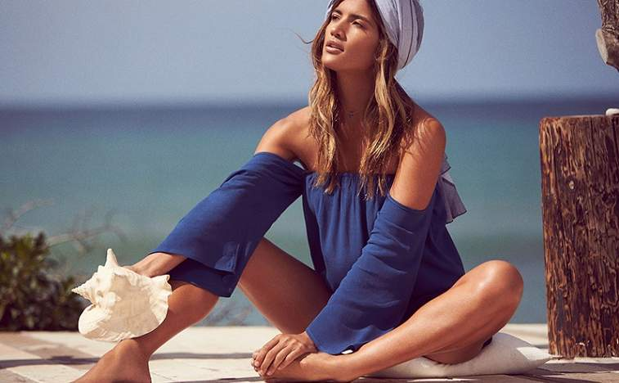
Business Aperture
Revolve Group
Data and Influencer driven fashion
NYSE : RVLV
Consumer Discretionary / Retail / E-Commerce Discretionary
Price: $37.85
Date 17th July 2019

Slide 2
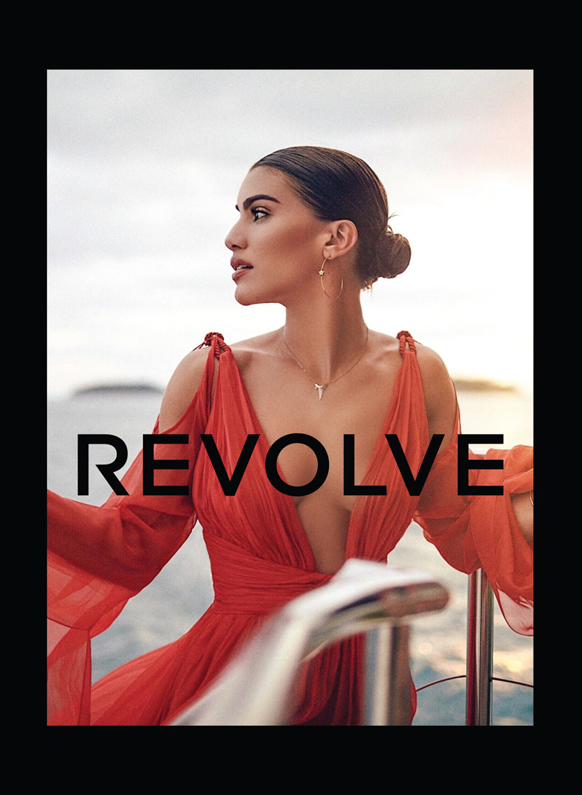




Summary
Business Aperture
Company Description
Started in 2003, Revolve is an online based fashion retailer targeting the Millennials and Generation Z consumers. Revolve offers over 45,000 apparel, footwear, accessories and beauty styles. They carry more than 500 established and owned brands, with a focus on premium lifestyle brands. Millennials are born between 1982 and 2000 and Generation Z are born after the 2000s.
What makes them Different
Revolve is unique due to their approach in using influencers to reach their consumers. Influencers are personalities on social media platforms such as Instagram, YouTube, Snapchat and Facebook.
By partnering with significant influencers while creating buzzworthy events, they ensure their marketing efforts deliver authentic, aspirational experiences and lifestyle content that drive loyalty and engagement.

Slide 3
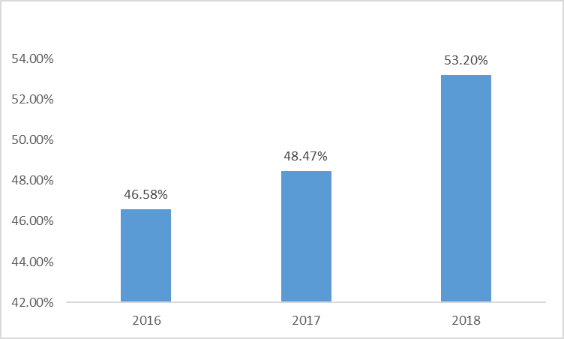
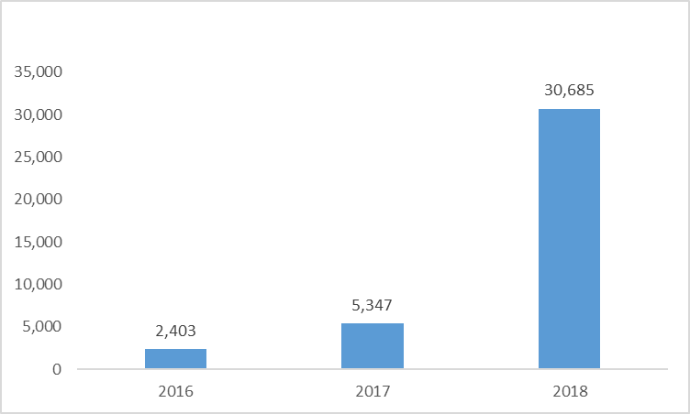
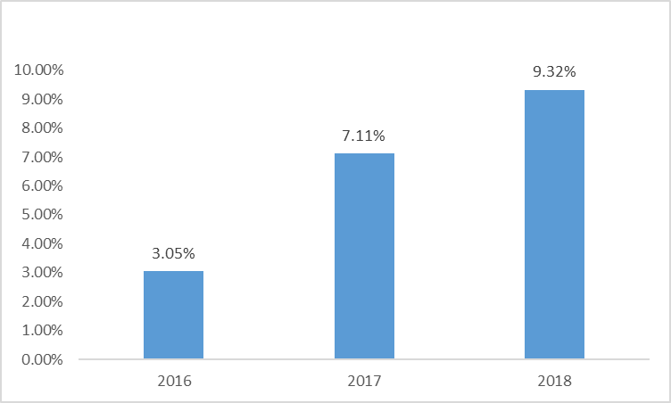
Selected Financial Metrics
Business Aperture
Net Sales
Gross Margins
Net Income
Adjusted EBITDA margins

Slide 4
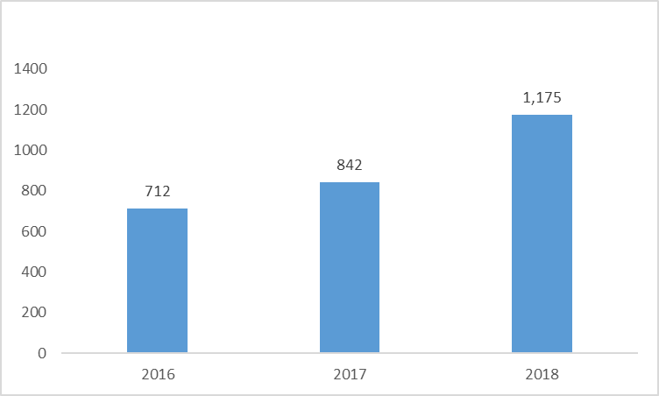
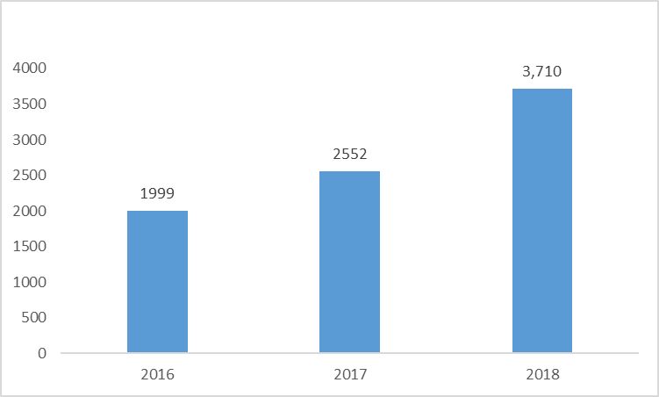
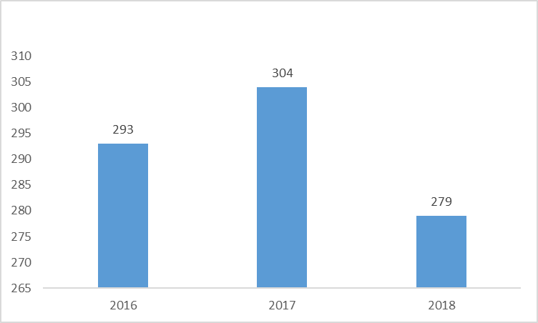
Selected Financial Metrics
Business Aperture
Active Customers
Total Orders Placed
Average Order Value
Company is highly liquid
- Revolve has 10% of its Total Assets in Cash
- The firm has a Current Ratio of 1.69
- They do not carry any form of interest bearing debt.
- They have an Asset light model with PPE worth less than 5% of Total Assets.

Slide 5
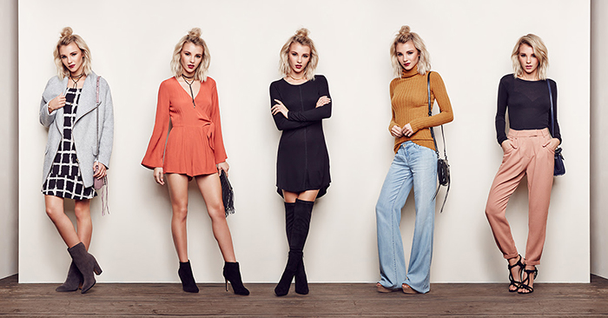
Social Media Lovers: Millennials and Gen Z
Business Aperture
The Digitally Savvy Millennials and Generation Z
It is very noticeable that the Millennials and the Generation Z (target demographic) are spending more and more time on digital media and less time on more traditional forms of print media
These consumers came of age in a hyper-connected, digital world, have unique shopping preferences, spend their time in different mediums, and respond to a different style of messaging than generations past.

Slide 6
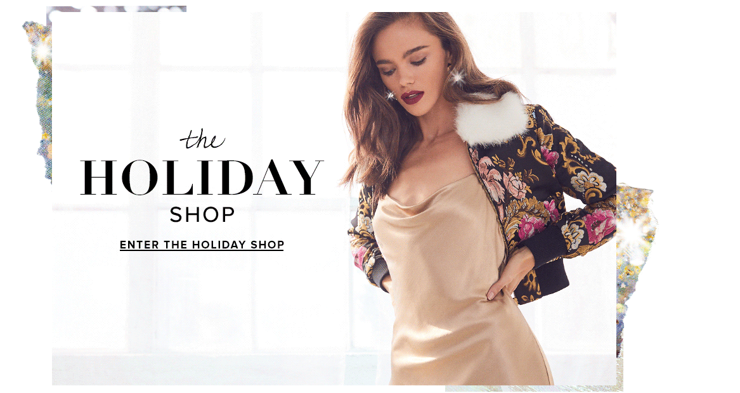
Social Media Lovers: Millennials and Gen Z
Business Aperture
Their connection and obsession with Influencers
So what does the Target Demographic Want?
1) They aspire to express their individual style through fashion and beauty.
2) They frequently seek an emotional connection with brands that are unique, on-trend and resonate with their values.
3) They look to social media and digital content from influencers as their source of inspiration and discovery and to inform their purchasing decisions.
Thus, Influencers have an outsized impact on the purchasing behaviours of next-generation consumers. Unlike traditional media, influencers are able to create personal connections with these younger consumers. They bring their followers into their daily lives and share their personal tastes and preferences in an authentic way.

Slide 7
Underserved group with large spending power
Business Aperture
Large Spending Power
According to the 2015 U.S. Census Bureau, Millennials accounted for more than 25% of the U.S. population, exceeding the number of baby boomers and making it the largest percentage of the workforce in the US. Further, according to the U.S. Bureau of Labor Statistics, people born after 1981, including Millennials and Generation Z, accounted for approximately $1.7 trillion or 22% of the nation’s total consumer expenditure in 2017. We expect this number to significantly increase as Millennials enter their peak earning years and an increasing percentage of Generation Z joins the workforce.
Revolve believes the market is Underserved
Department stores and national retailers try to serve a broad demographic with ubiquitous brands and are slow to react to changing trends.
Specialty boutiques, while highly curated, often offer a narrow assortment and are limited in their reach.
Online retailers tend to deliver a purely transactional customer experience, with limited original fashion content and style advice to facilitate inspiration and discovery.
Hence Revolve believes that they are fast to react to trends, able to increase their reach with number of brands they carry and provide a deeply connected customer experience with original fashion content. Heavily poised to capitalize on this sizeable yet underserved market.

Slide 8
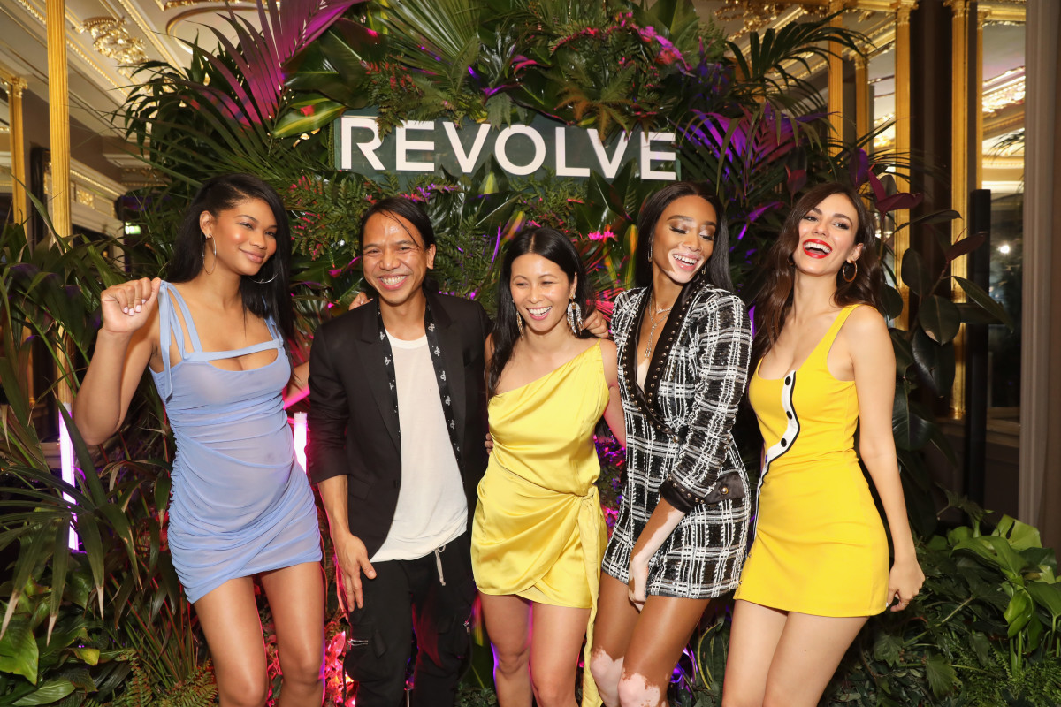
Freshness in Revolve’s Products
Business Aperture
Self created brands
Revolve does not just rely on partner brands. It built a portfolio of 21 owned brands, each crafted with unique attributes and supported by independent marketing investments. This has made the brands perceived as independent brands which are highly desirable, rather than private labels or house brands. This is shown in their own brands representing eight out of top 10 brands and generating 32.6% of net sales. Owned brands have higher average unit revenue and generate higher gross margins.
Freshness in the products they release
The freshness has resulted in 79% of their net sales in 2018 being at full price. They believe that they are more targeted than mass market stores and provide a greater selection than speciality retailers.

Slide 9

Industry
Business Aperture
Huge US market expected to grow
The U.S. apparel and footwear, accessories and beauty market was $564 billion in 2018 and is expected to reach $622 billion in 2021, growing at a CAGR of 3.3%.
Growth driven by Online Sales
The U.S. online apparel and footwear, accessories and beauty market was $117 billion in 2018 and is expected to reach $170 billion in 2021, growing at a CAGR of 13.2%.
Reason for online growth
Consumers are increasingly using digital channels to make purchases, and as a result, the growth of online sales has outpaced that of traditional brick-and-mortar channels. Mobile sales in particular have rapidly increased as consumers leverage their ability to discover, browse and purchase anytime from anywhere through their smartphones.
According to Euromonitor International, Ltd., a market research firm:

Slide 10
Competitive Strengths
Business Aperture
Leading Millennial Destination for Premium Online Fashion
Innovative Marketing Approach
In 2018, they generated $498.7 million in net sales, serving approximately 1,175,000 active customers with an average apparel order value of $279. Generated 9.8 million unique visitors per month in 2018 compared to the 7.8 million in 2017, showing sustainability and growth in their business.
Through their network of over 3,500 influencers and buzzworthy social events, 56% of traffic for REVOLVE was driven from free and low-cost sources. They also have over 5.5 million followers. Sophisticated performance marketing efforts includes retargeting, paid search/product listing ads, affiliate marketing, paid social, search engine optimization, personalized email marketing and mobile “push” communications. This strategy allows Revolve to efficiently increase brand awareness, promote customer acquisition, encourage retention and maximize lifetime customer value.
Strong interaction and connection with consumers
By engaging with customers through social media, events and other channels, Revolve generates multiple touchpoints. They integrate their marketing content with our product curation, visual merchandising, and editorial content, using a “Hot List,” daily product stories, and head-to-toe style suggestions to create an inspirational user experience and enhance their reputation as a fashion discovery destination.
Data-driven Merchandising Model
The model allows Revolve to offer a broad, yet curated assortment of on-trend apparel and accessories while minimizing fashion and inventory risk. It does so by combining qualitative and quantitative decision-making to identify trends, curate assortments, facilitate merchandise planning and re-order processes, and manage pricing.

Slide 11
Growth Strategies
Business Aperture
Customer Acquisition
Increase Customer Loyalty
They generate significant return on customer service investments. Contribution margin from customer’s initial order exceeds customer acquisition cost and repeat purchase behaviour generates attractive ratio of customer lifetime value to customer acquisition cost. They believe they are less than 3% penetrated into their target demographic and aim to convert young consumers into active customers as they enter peak earning years.
Enhancing customer experience will strengthen their loyalty. This will be achieved via refinement of customer segmentation, increasing personalization, launching progressive web apps for mobile site and providing additional opportunities to pre-order coveted products. They also plan to expand their preferred customer programs, which sends high value customers curated products specially via Revolve Stylists.
Grow Owned Brands
Expand International Markets
The percentage of the REVOLVE segment’s net sales represented by owned brands reached 35.8% for the three months ended March 31, 2019. The plan is to continue optimizing their assortment to drive revenue and profitability growth by introducing new owned brands and expanding their current owned brands into additional styles and categories.
In 2018, 45% of Revolve’s social media followers across Instagram and Facebook were located outside of the United States. However net sales shipped to customers internationally represented 17.9%. Revolve began offering a more localized shopping experience to customers in the UK & EU by offering prices inclusive of regional taxes and duties and improving our distribution and fulfilment capabilities to simplify the ordering and return process.

Slide 12
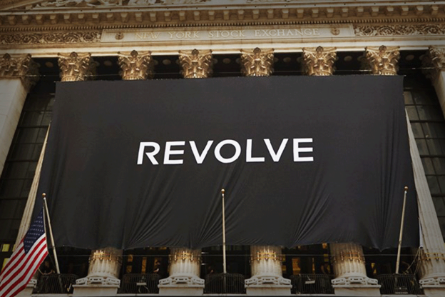
Possible Dangers
Business Aperture
Relatively New Company in Online Space
Many of Revolve’s competitors have, and potential competitors may have, longer operating histories, larger fulfilment infrastructures, greater technical capabilities, faster shipping times, lower-cost shipping, larger databases, greater financial, marketing, institutional and other resources and larger customer bases than Revolve has.
Web Stickiness yet to be firmly established
It is understood that in the online fashion industry, sales need to be driven by “web stickiness”. It is hard to tell how long a product will remain “hot”.
High P/E ratio
20% growth is not sufficient enough for this 80+ P/E ratio. If growth slows, the valuation multiple will compress.
Other Concerns
Other risks include the rapid changes in the operating field, competitive marketplace, reliance on social media, and influencers + selling investors appear to be happy to step out of the shares at the offer price.

Slide 13
Upside
Business Aperture
Distinguishable and Recognizable brand
It is a rule that fashion and lifestyle brands need to carve out a notable prescience on social media. Revolve Group has done so using Influencers.The focus on personalisation, loyalty, and usage of influencers has resulted in the company distinguishing itself from its competitors.
8 of 9 Analyst rate the Stock a Buy on Bloomberg
Jefferies' Randal Konik, who said, "Revolve is the future of retail and brand marketing with its digital commerce platform built on a data-driven backbone and an enviable influencer ecosystem," and gave it a price target of $60, higher than any other analyst.
Oliver Chen of Cowen joined the chorus, saying, "Revolve is well-positioned to grow its active user base as it captures fashion-focused Millennial and Gen-Z shoppers through its on-trend assortment, its influencer-based marketing model, and its emphasis on experiential events to promote the brand."
The lone hold rating came from Barclay's Ross Sandler, who liked the company's business model and financials but was concerned about the valuation.
The analysts widely cited Revolve’s financial performance, influencer marketing strategy and opportunities to expand internationally as key differentiators and growth drivers.
https://www.bloomberg.com/news/articles/2019-07-02/revolve-draws-slew-of-bull-ratings-on-savvy-influencer-strategy

Slide 14
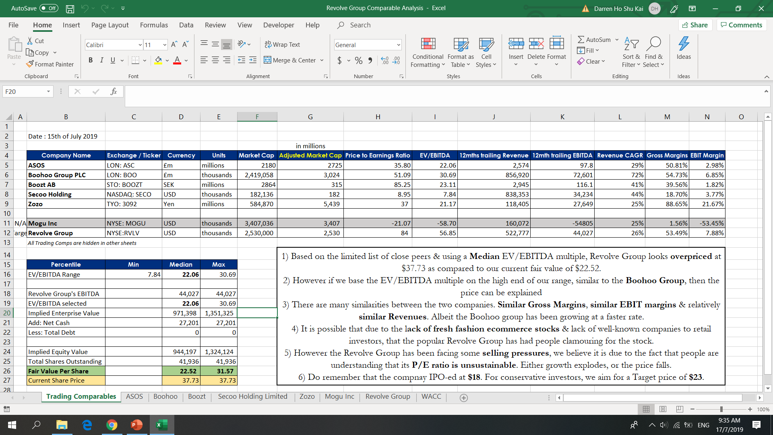
Valuation Summary (refer to excel)
Business Aperture

Slide 15
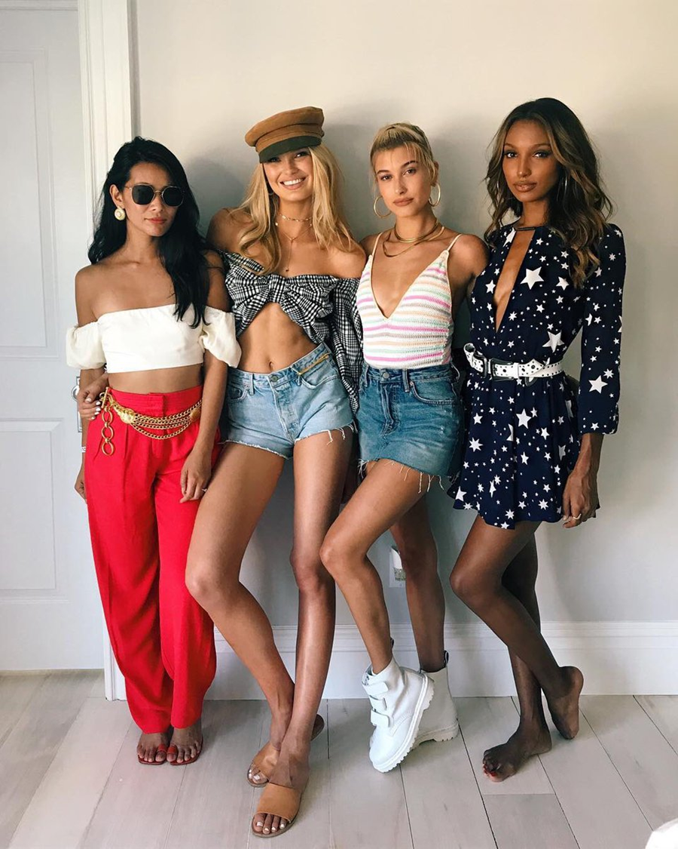
In Summary
Business Aperture
Key growth drivers
> Favourable demographic trends,
> Constant product newness / freshness
> Proliferation of emerging brands
> An increased focus on fashion and beauty as a reflection of self-expression.
Overall
Revolve has over 15 years of heavy investment in data-driven intelligence has catapulted the company to a position of fashion retail dominance that serves the needs of millennials and Generation Z demographics.
Revolve's success in attracting customers using influencers complemented with its strength in personalizing purchases to individual customers will continue to fuel growth going forward.
Perhaps Revolve has found the formula after all.

Slide 16
Others / Annex
Business Aperture
Good Links for Reading
https://www.inc.com/michelle-cheng/how-revolve-has-built-a-billion-dollar-fashion-company-for-millennial-women.html
https://fortune.com/2015/11/11/revolve-clothing-profile/
https://qz.com/quartzy/1433517/asos-and-revolve-are-quietly-revolutionizing-the-private-label-brand/
https://seekingalpha.com/article/4270104-strong-debut-revolve-demonstrates-growing-interest-kol-led-e-commerce-chinese-peer-mogu-3
Other Notable Comps not listed in Excel
1) Zalora ( owned by Global Fashion Group)
2) Net a porter ( owned by Richemont Italia Holdings S.p.A)
3. Zalando (owned by Kinnevik AB)
4. Shopbop (owned by Amazon.com
5. Stitch Fix (Styling service
6. Farfetch (Luxury portal)
7. Capri Holdings (Conglomerate)

