Slide 1
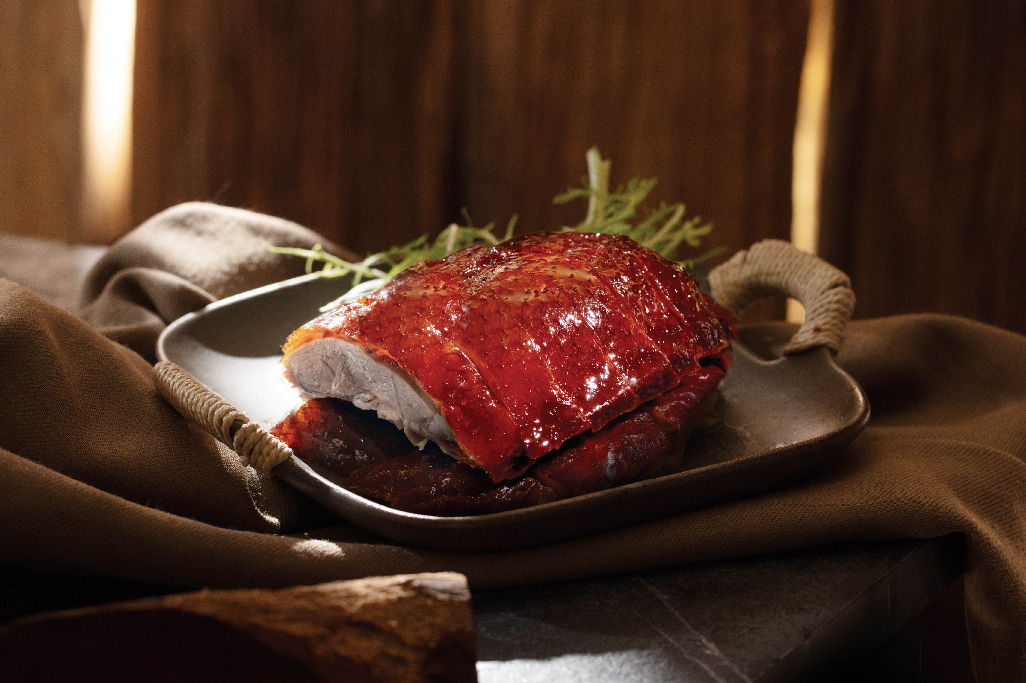
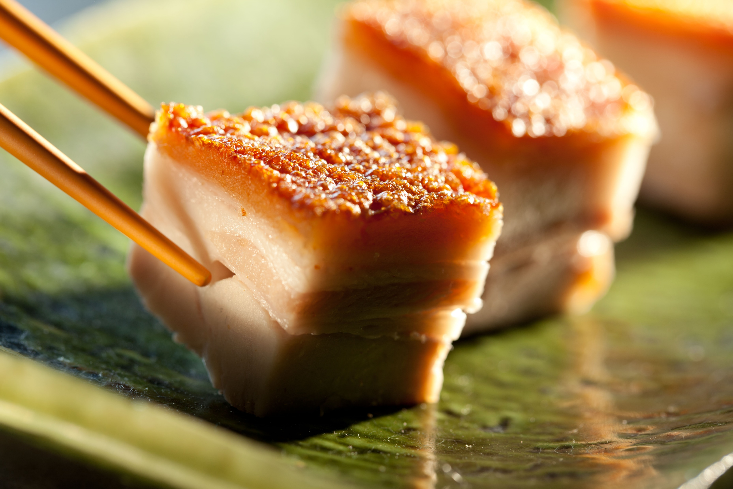
Business Aperture
Tai Hing
Exchange: HKEX
Services / Restaurants & Fast Food Shops
Ticker: 06811.HK
Price: HKS2.59
Date : 8th of July2019

Slide 2
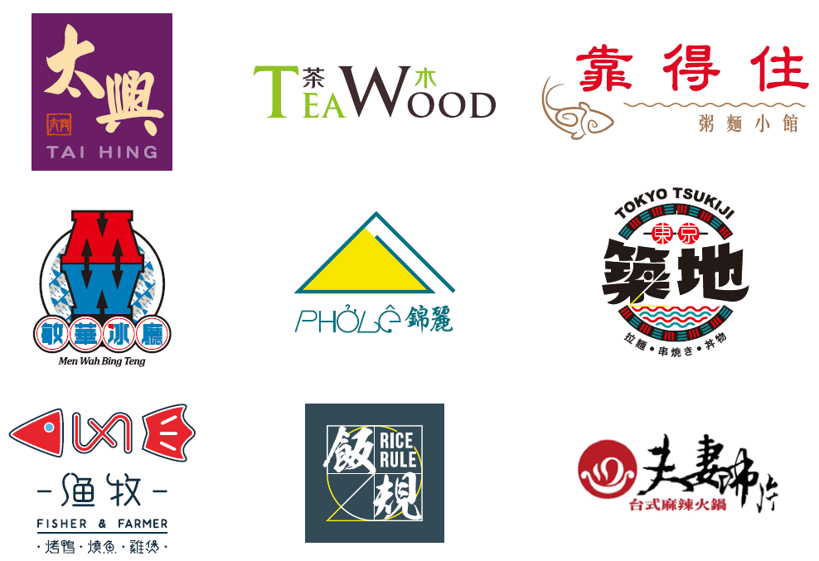
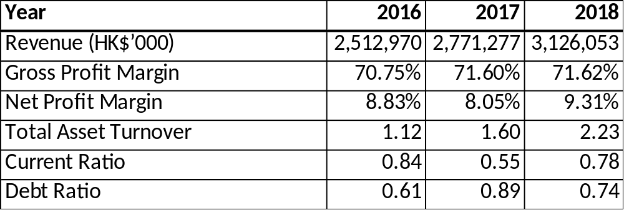
Company Overview
Business Aperture
Background
Tai Hing is a Multi-Brand Casual dining restaurant group which originated from Hong Kong. They have 9 brands and operate 191 restaurants. 126 in Hong Kong, 63 in China, 1 in Macau and 1 in Taiwan. They offer Chinese (Cantonese, Sichuan and Beijing and Taiwanese cuisines), Vietnamese and Japanese cuisines. Between the period of 2016 an 2018, they have opened between 28 and 32 restaurants a year.
Key Financial Information

Slide 3
Financial Metrics
Business Aperture
Revenue
Gross Profit Margin
Net Profit Margin
Total Asset Turnover

Slide 4
Financial Metrics
Business Aperture
Current Ratio
Quick Asset Ratio
Debt Ratio
Interest Coverage Ratio

Slide 5
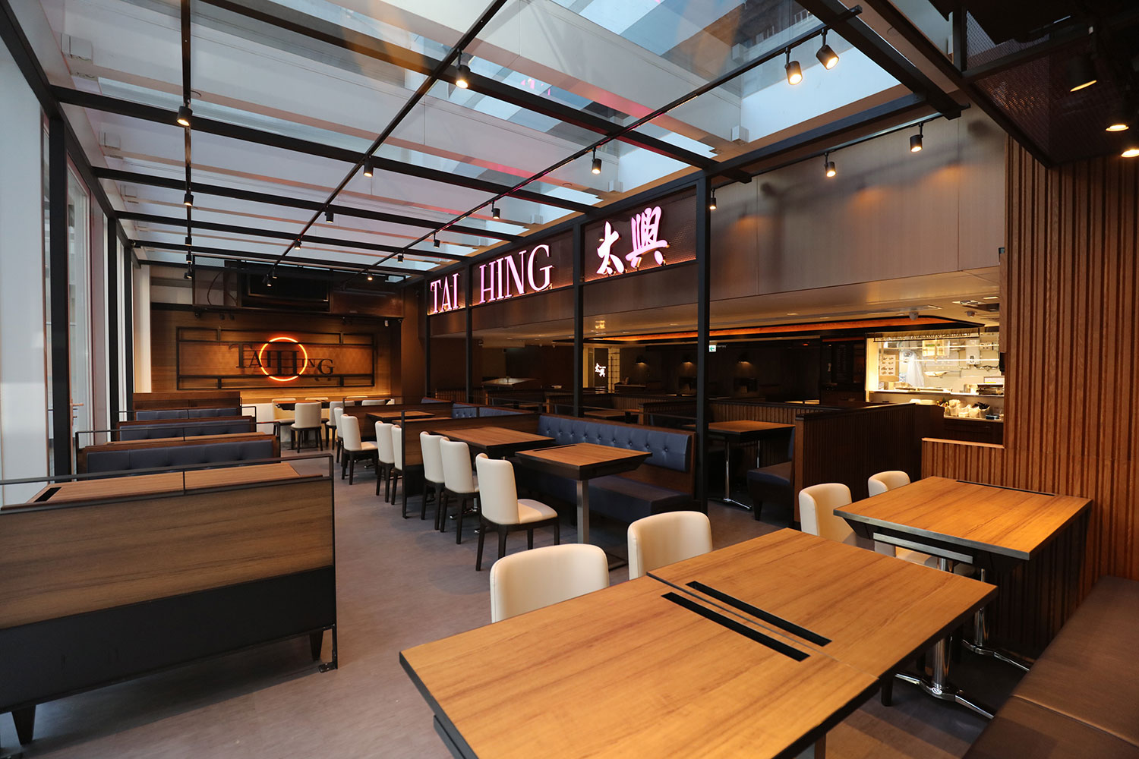

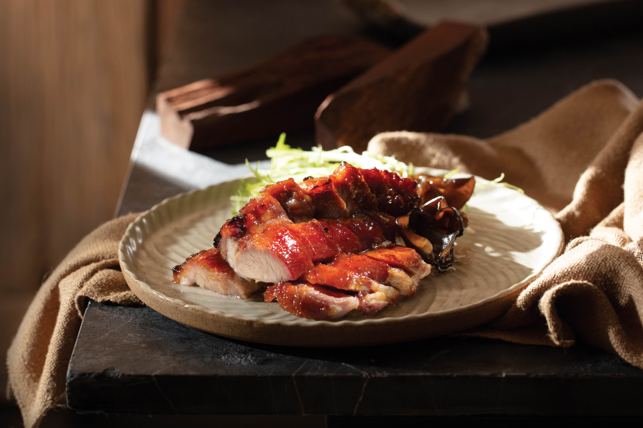
Brands – Tai Hing
Business Aperture
Tai Hing
The first chain established by Tai Hing Group, it is a Hong Kong style quick and easy comfort food for casual diners with 103 restaurants. The signature dishes includes Chilled Milk tea, 5-Star Roast Pork, Sweet and Sour Pork, Barbecued and Marinated Platter and Rice Noodles with Beef in Swiss Sauce, to name a few.
Greatest emphasis is placed on the Siu Mei (Roast pork, Roast goose etc), with the factory delivering food and delivering to restaurants three times a day. The China restaurants serve more stir-fry dishes to target customers with higher spending power, who would frequent Tai Hing for business events or family events.
Large tables with comfortable seating
Chilled Milk Tea
Roast Pork

Slide 6
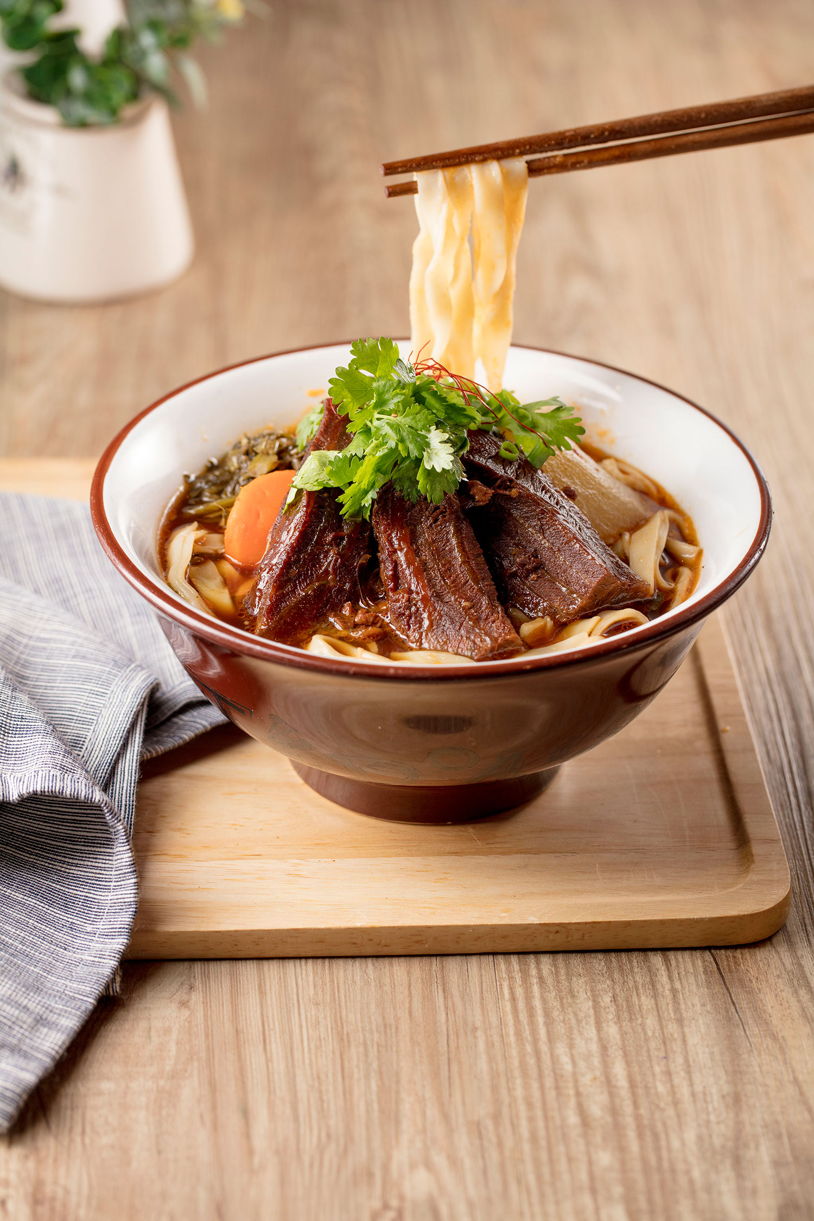
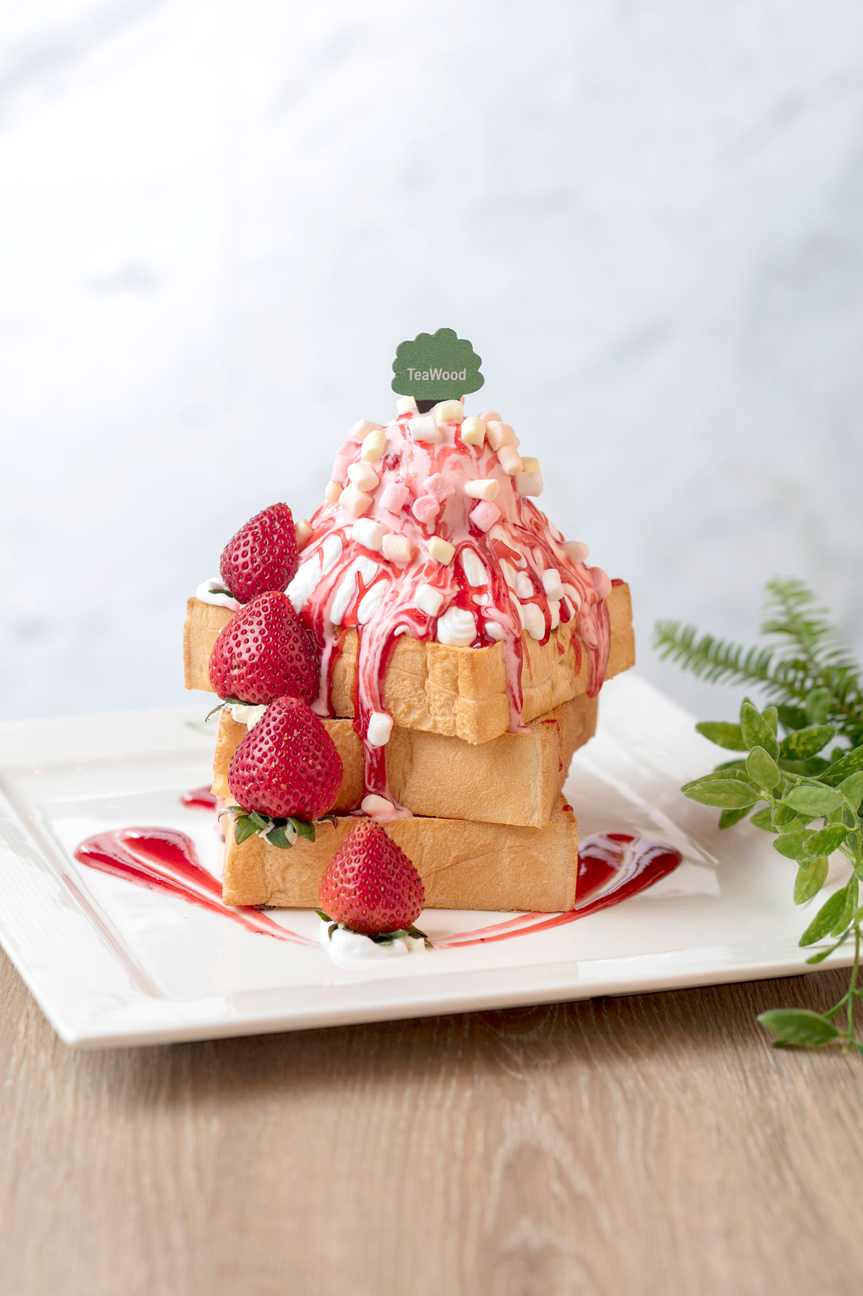
Brands – TeaWood
Business Aperture
TeaWood
TeaWood serves Taiwanese Style Cuisine and desserts in a modern and comfortable environment suitable for couples and friend gatherings. The target customers are young hence a bright fresh appeal is needed.
The “TeaWood” brand ranked first in terms of the number of self-operated restaurants in the Taiwanese casual dining market in Hong Kong.
Currently operating 32 stores, TeaWood restaurant and cafes are relatively large with a seating capacity between 56 and 148. The menu is extensive as its targets customers who are looking for a full meal.
A sub-line is the Little TeaWood with a café style interior design and a smaller restaurant size with a capacity of around 25. Target customers are those looking for lighter meals or tea time snacks.
Noodles with Stewed Beef
Strawberry Ice Cream
Honey Toast

Slide 7
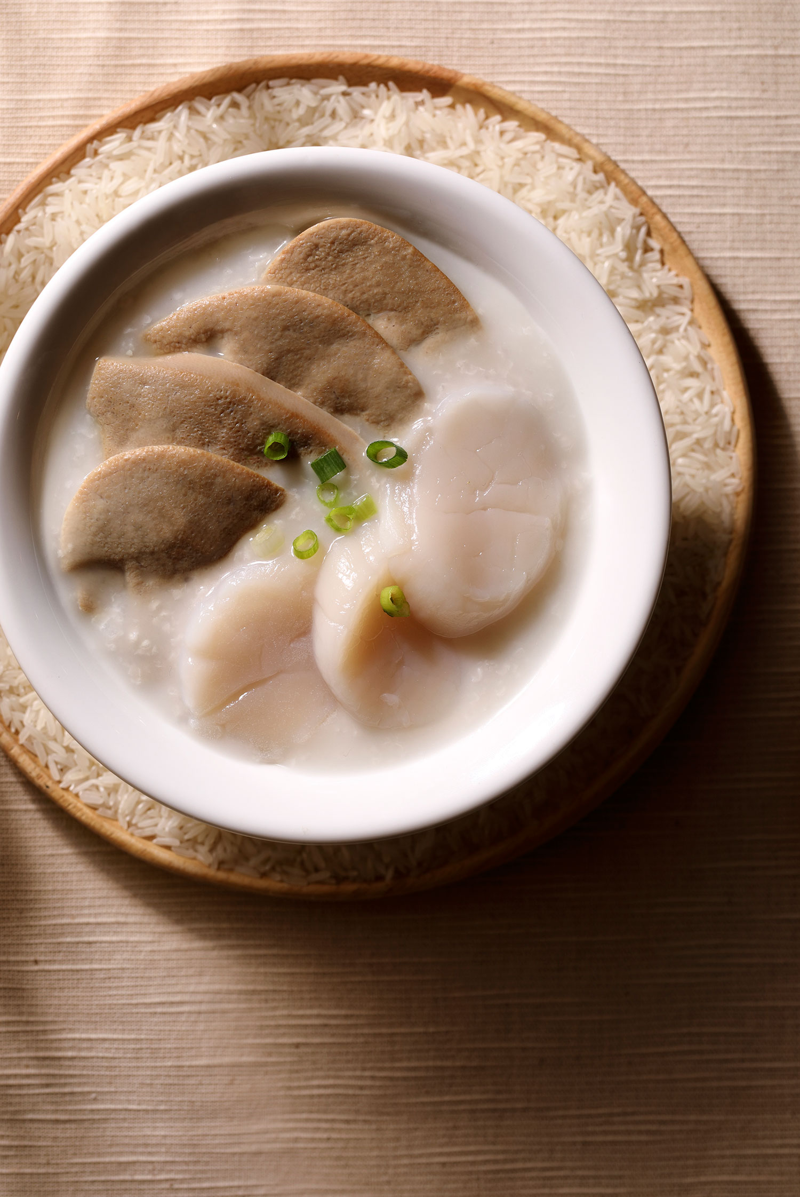
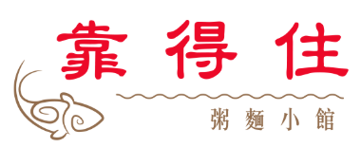
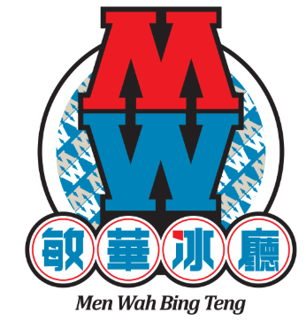
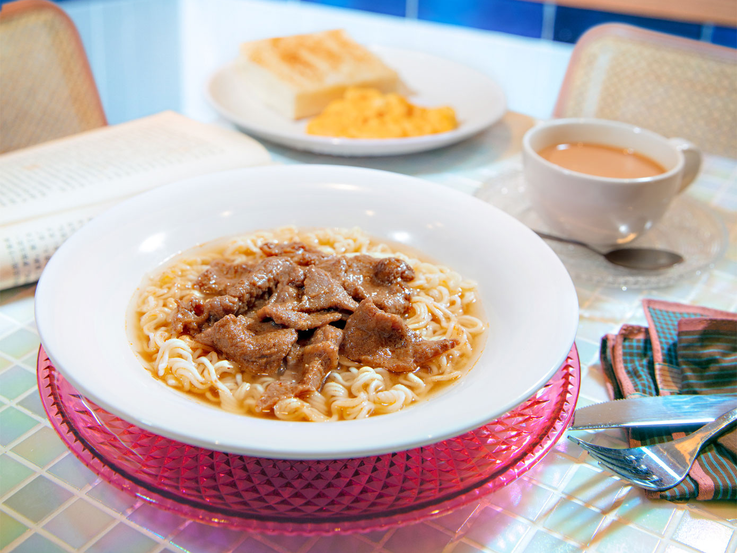
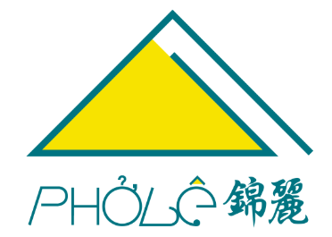
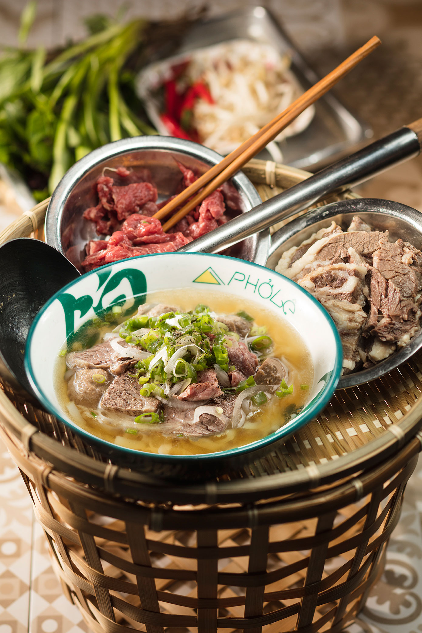
Brands
Business Aperture
Trusty Congee King
Acquired in 2008, Trusty Congee King has been a Michelin Recommended Restaurant for seven years straight, subsequently being conferred the Bib Gourmand award in the Hong Kong Macau guide for 2018 and 2019. The restaurant serves traditional Chinese cuisine with a focus on Congee (Porridge). 19 outlets operating. Signature dishes includes Fish Belly Congee and Shrimp Wonton Soup Noodles.
Acquired in 2016, Man Wah Bing Teng is a “bing sutt” house, a traditional old-fashioned cold drinking house from the old days of Hong Kong with a hint of Western influence. To provide a nostalgic environment, the layout is reminiscent of “bing sutt” houses in the 1960s. Signature dishes include BBQ Pork with Rice, Egg in Boiling Water and Sa Cha Beef Noodles.
Pho Le
Ranked 23rd out of 2000 restaurants in Trip Advisor’s Ho Chi Minh City ratings, Tai Hing holds the exclusive business owner of Pho Le in Hong Kong, China, Macau and Taiwan. Originating from a local noodle store in Vietnam, famous dishes include Pho with medium rare beef, shrimp and Vietnamese sausage paper rice roll & French style butter chicken wings.

Slide 8
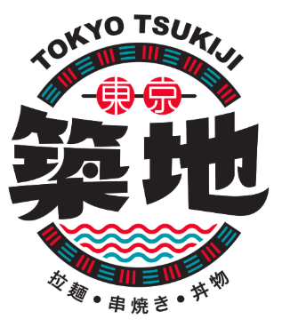
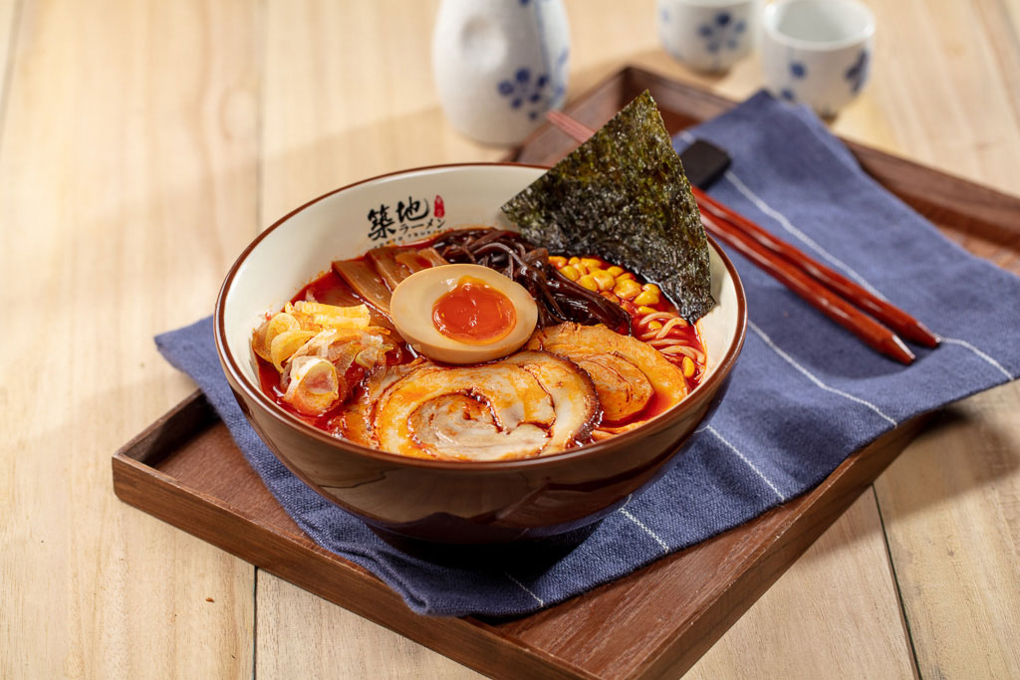
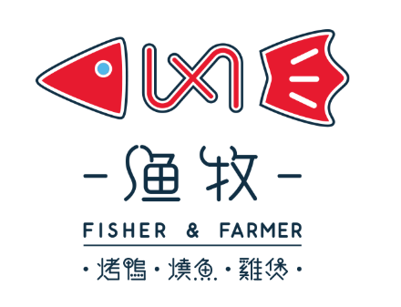
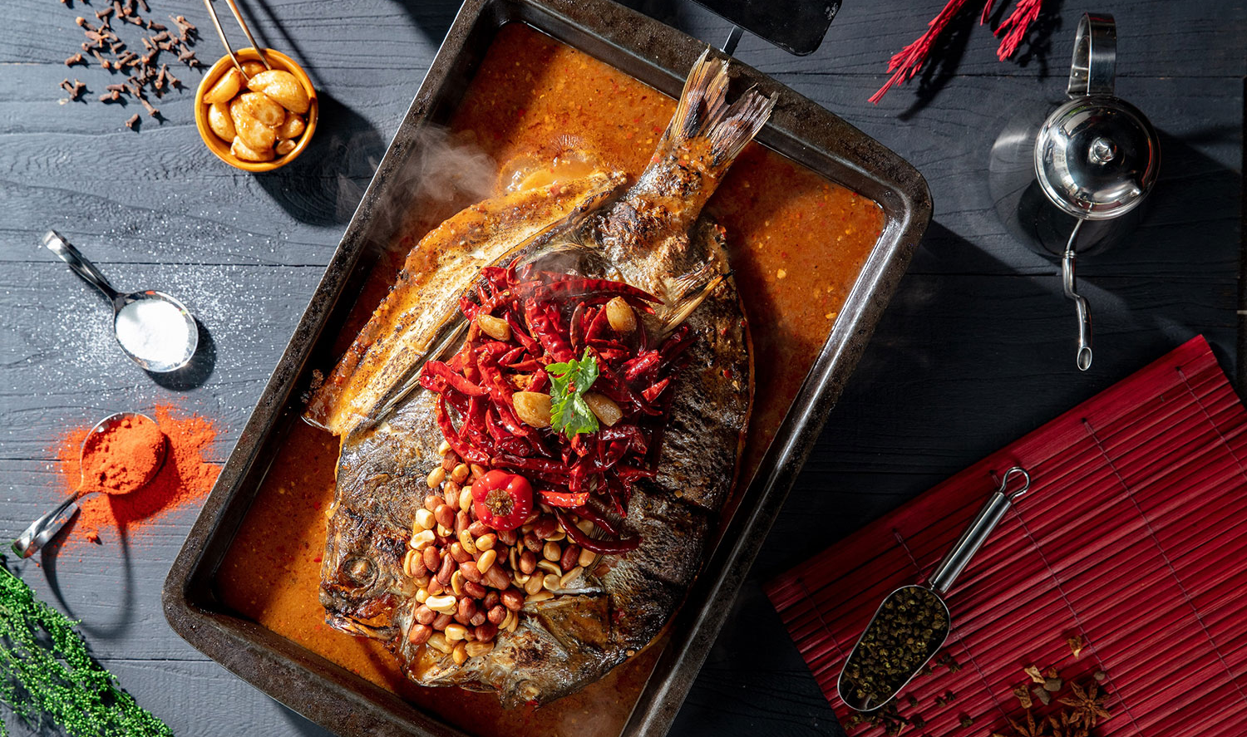
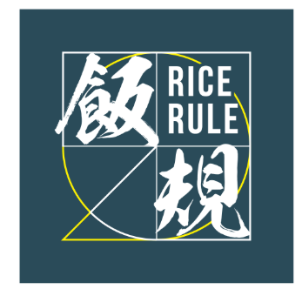
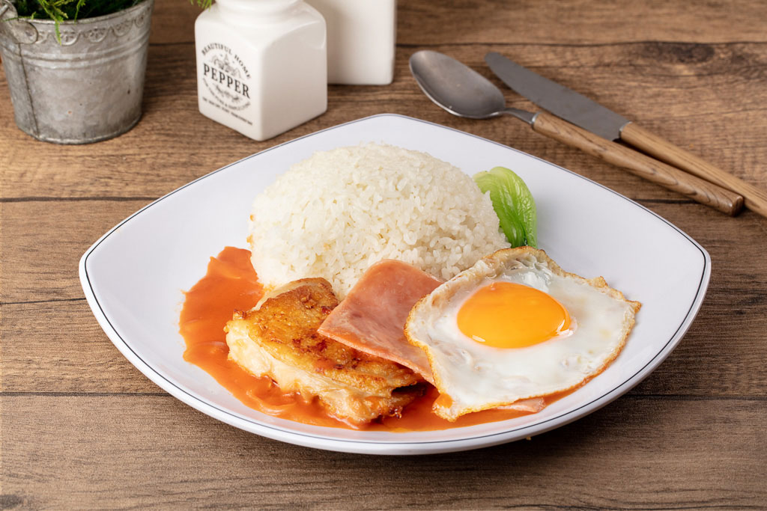
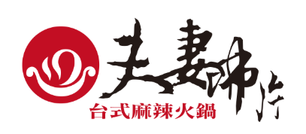
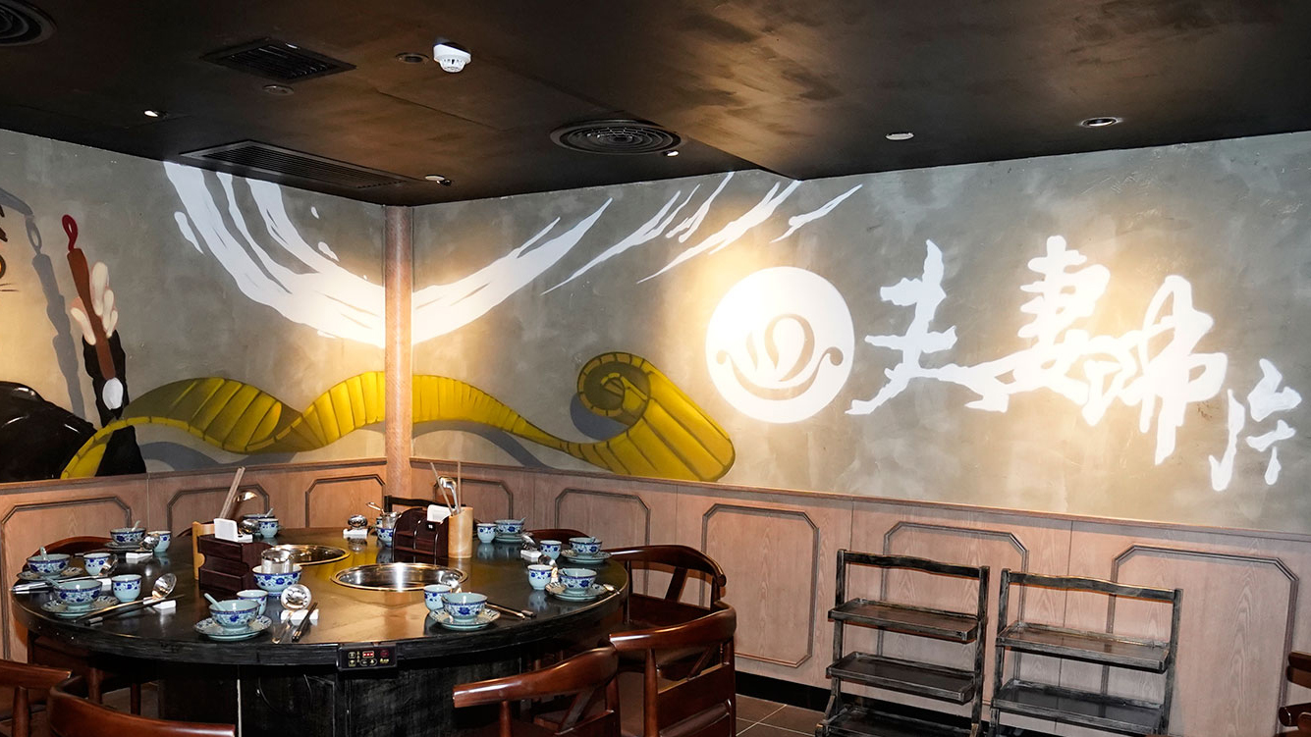
Brands
Business Aperture
Tokyo Tsukiji Restaurants offer Japanese cuisine with a focus on ramen, along with skewers and Japanese style dons. 3 restaurants in Hong Kong.
Fisher & Farmer serves signature dishes of Beijing and Sichuan, upon noticing rising market demand of certain specialty cuisines. Famous dishes include Boiled Fish with Bean Sprouts in Hot Chili Oil, Peking Duck and Signature Chicken in Casserole.
A Fast Food Canteen where customers are expected to self serve.
The Most recent addition to the team, Hot Pot Couple focuses on servingTaiwanese-style spicy hotpot and fresh ingredients. The design and décor are reminiscent of a traditional Chinese Tea House.

Slide 9
Size of Catering Service Market – Hong Kong
Business Aperture
Segmentation of Market
Market Size and Growth
The Casual Dining Market is the largest in Hong Kong, taking 40.6% of the Catering Service Market, followed by the Fine Dining Sector at ~38%. It is projected to remain this way.
The Casual Dining Market in Hong Kong is valued at 47.8 billion HKD and is projected to grow at a modest pace of between 3 and 4%. The fastest growing segment would be the Quick Service Restaurant Segment.

Slide 10
Size of Catering Service Market - China
Business Aperture
Segmentation of Market
Market Size and Growth
The Casual Dining Market is the small in China, taking 11%% of the Catering Service Market, with the Fine Dining Segment taking the top spot. It is projected to improve in the coming years.
The Casual Dining Market in Hong Kong is valued at 484 billion HKD and is projected to grow at an explosive pace of between 8 and 10%. They are expected to be the fastest growing segment, alongside the Quick service segment.

Slide 11
Landscape of Casual Dining Market - HK
Business Aperture
High segmentation
Trends in food delivery
5000 casual dining restaurants. Heavily segmented. Top three players generating 8.4% of total revenue. In 2017, Tai Hing was the largest casual dining group in terms of revenue of casual dining restaurants and also number of self-operated restaurants, in Hong Kong. 2nd group had 2.7% market share Cha Chaan Teng restaurant listed , 3rd group had 1.7% market share, operates all forms form casual dining to QSR.
Food delivery grants customers flexibility in food ordering and venue selection, and therefore enables the casual dining market to reach greater customer base. Food delivery services such as Foodpanda & UberEats are becoming increasingly popular among consumers in Hong Kong. More food delivery services providers are partnering with restaurants across different districts, increasing the penetration rate of delivery service.
Popularity of green dining
Technology integration
Consumers in Hong Kong are becoming increasingly aware of the origin of food that they consume. With information circulating on social media regarding to the origin of food ingredients, such as where vegetables are harvested and the methods farmers use to treat live stocks. Therefore increasing number of restaurants in Hong Kong are sourcing sustainable raw food materials product and promoting healthy and organic eating.
One example is the electronic ticketing system that has been adopted by larger chain restaurants in Hong Kong are accessible through the kiosk terminal at the entrance of the restaurant and accessible through mobile application, allowing customers to remotely receive their ticket prior to arriving at the restaurant and also providing the estimated waiting time. This implementation benefits the reception staff to focus on directing customers to an available table.

Slide 12
Growth Drivers for Casual Dining Market - HK
Business Aperture
Rising disposable income
Sustainable Tourism Market
According to the IMF, per capita gross national income in Hong Kong is expected to increase with a CAGR of 4.5% till 2023. With the increase in income, the spending on food grows accordingly and more people shift from preparing and having meals at home to dining out. Household expenditure on food in Hong Kong is expected to continue to grow at a CAGR of 3.1%.
Tourists are one of the targeted customers of casual dining restaurants in Hong Kong. Supportive government policies in promoting tourism leads to the rising number of tourists which supports the growth of casual dining market in Hong Kong. According to the Immigration Department, the total visitor arrivals in Hong Kong realized a CAGR of 1.9% and the upward trend is expected to be maintained.
Diversified cuisine offerings
Holistic Dining Experience
Hong Kong has always been known as a gourmet’s paradise for an unlimited variety of food and dining from Chinese cuisine, Western cuisine and Asian cuisine. Leading casual dining providers adopt multi-brand strategy and operate chained restaurants to offer diverse cuisine types for both local and tourists in Hong Kong.
Customers are now embracing a more holistic dining experience, from the quality of food to the service and the concepts of the restaurants. The industry is embracing a more comfortable dining environment to attract customers, at competitive prices and good food whilst adopting the concepts that address the concern of customers, such as healthier and seasoned menu offerings.

Slide 13
Landscape of Casual Dining Market- CN
Business Aperture
Prevalence of food delivery platform
Innovation of product & service
The rising penetration of the mobile internet as well as no-cash payments, has resulted in a strong uptake in food delivery services in China. Along with the cooperation between restaurants and food delivery service providers, the penetration of food delivery service is expected to
grow
Some casual dining restaurants offer additional service like photo stickers, video games when customers are queuing for the table. New ingredients and dishes are the key to attract customers and maintain their interest in the restaurants.
Largely Fragmented Industry
Increasing standardization and expansion
Top 5 players account for 0.7% of the market. Tai Hing is one of the leading self-operated casual dining groups in Mainland China in terms of revenue of casual dining restaurants, with a market share of 0.1% of total casual dining market
An increasing number of casual dining restaurant operators begin to expand their store network to enlarge their business and coverage of target customers. An extensive network is likely to increase exposure of the brand. Meanwhile, standardization of products and services is the key to ensure the quality and safety of the dishes, using central kitchens is one example.

Slide 14
Growth Drivers for Casual Dining Market - CN
Business Aperture
Increasing per capita disposable income
Changing lifestyle
According to the National Bureau of Statistics, the per capita annual disposable income of urban households increased with a CAGR of 7.8% over the past few years and is expected to increase similarly at around 7.6% over the next few years.
Consumers are gradually changing their lifestyle such as growing habits of dining out. Casual dining restaurants provide diversified types of food with moderate prices, especially theme restaurants which are popular among young customers, are attracting middle to mass customers including white collars and tourists.
Diversified dining culture
Development of technology
Chinese cuisine includes cuisine originating from the diverse regions of China based on the raw materials and ingredients used the method of preparation and cultural differences. In addition to Western cuisine and Asian cuisine, there is emerging number of forms of fusion cuisine. These are expected to expand the market
Technology adoption has accelerated the growth of the
market. New technologies such as automatic ordering and automatic queue management provide a better dining experience for consumers. On the other hand, it has supported the operational management and enables to improve management efficiency through various aspects including seating space optimizing and the supply chain.

Slide 15
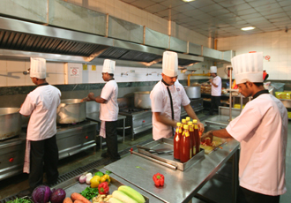
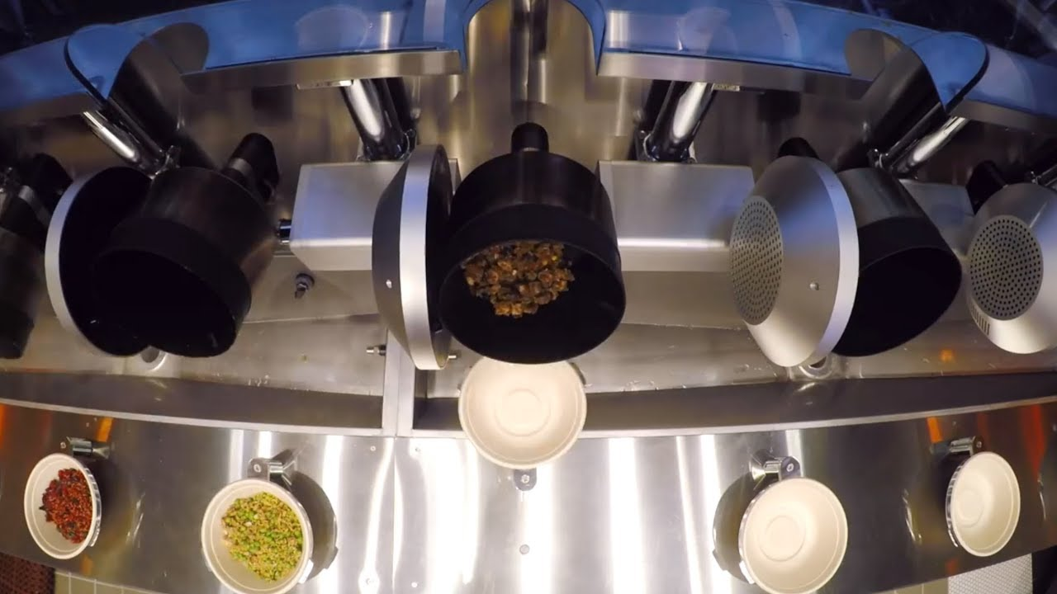
Strengths
Business Aperture
Centralized Kitchen
Automated production and food preparation processes:
Hong Kong Factory supplies 60% of all raw materials, semi-processed or processed food ingredients used in the Hong Kong restaurants. This ensures quality consistency, reduces food wastage, improves space efficiency of restaurants by reducing the kitchen space and storage space required, and reduces workload on restaurant-level chefs in respect of the initial stage of food ingredients processing allowing more focus on the final stages of food preparation. China’s Food Factory is operational of the end of 2018.
Automated woks with synchronised voice prompt, programmed barbecue pork sauce mixers, programmed
chicken poaching machines and programmed poultry roasting ovens. reduce the skill level required of kitchen staff and minimise repetitive motions and heavy-lifting in cooking processes. Obtained three innovative applications patents for automated food processing machines. Allowed them to hire employees with less skill and experience giving HR more flexibility.
Results in
Highly standardised operation
Allows the standardisation of key production process of the dishes and maintain a uniformly high quality of the dishes.

Slide 16
Strengths
Business Aperture
High Quality Control
Securing Prime Locations
Food Factories follow the HAACP standard. Siu Mei production unit was awarded the ISO 22000 certification. Tai Hing implements the “5-S” management system.
Due to Tai Hing’s strong Brand Recognition, it is able to achieve Stronger leverage in securing favourable terms in
leasing desirable restaurant locations catering for their strategic needs.
Ability to Capture Diverse group of customers
With 3 major cuisines covered, the extensive brand portfolio is able to cater to the everchanging and demanding taste buds of consumers.
Benefits of strengths mentioned
Tai Hing’s strengths allows it to have a Replicable Operation Model, while taking experiences gained from one business and transferring to another chain.
1) Maximises the profitability
2) Achieve economies of scale
3) Establish a scalable business model
4) Ensure consistency in dish portion and quality
5) Control Operational Costs
6) Create a safer and healthier working environment
7) Easier recruitment and retention of experienced management and other staff
Bargaining Power
Higher bargaining power with suppliers and service providers for competitive prices, priority supply and customised ingredients and services.
Fast Breakeven Point
Typical range of breakeven period of restaurants generally range form 2 to 4 months. The typical range of investment payback period of the restaurants is 12 to 26 months.

Slide 17
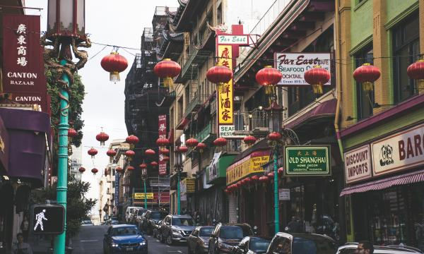
Opportunities & Growth in China
Business Aperture
Strong Presence in China
Starting in 2004, Tai Hing now has 58 restaurants in Mainland China, mostly under the brands “Tai Hing”, “TeaWood”, “Trusty Congee King” and “Pho Le”. They operate in 12 cities including Shenzhen, Beijing, Shanghai, Guangzhou, Shenyang, Hangzhou and Tianjin. Tai Hing ranked second in terms of revenue in the self-operated casual dining market in Mainland China in 2017.
Increasing Capacity
14 years of operation in the Mainland China has allowed the team to have accumulated knowledge and experience in identifying business opportunities and developed a restaurant operation model that suits the consumption pattern of the Mainland Chinese. To maximise the benefits of the solid foundation established, a Food Factory has been recently set up and commenced, able to support up to 200 restaurants. Giving them capacity from the 58 they have now.

Slide 18
Forward Looking Strategies
Business Aperture
Hong Kong
China
1) Developing new brands
Launching of new restaurants offering cuisines that are different from existing offerings. “Hot Pot Couple”, which serves Taiwanese Spicy Hotpot has been opened. There are also plans to open a restaurant which would serve sophisticated Cha Chaan Teng style delicacies. 2 of these restaurants are expected to be opened.
2) Increase penetration of current brands
There are plans to open new restaurants under Hai Ting’s existing brands. Specifically 18, 19 & 20 expected in 2019, 2020 and 2021.
1) There are plans to open 11-13 stores yearly between 2019 and 2021 to enhance market penetration, with the focus on first-tier cities and the greater bay area.
2) Mainland China restaurants have been running with their respective standalone kitchens previously without the support of the central kitchens. Hence the benefits are yet to be reflected.
3) Continuous refinement of the brands retail concept, which includes, tailoring the menu items to cater for the taste preferences of the locals, adjusting the restaurant size and restaurant locations to better capture our target customers and taking a better balance between the marketing effect and the rental cost of the restaurant premises.
Taiwan
With Taiwan’s catering service market expected to grow at a CAGR of 8% till 2022, there are plans to open 1 to 3 restaurant form 2019 to 2021.
Tai Hing has entered into the Taiwan Joint Venture Agreement to set up a joint venture company to open and operate restaurants.

Slide 19
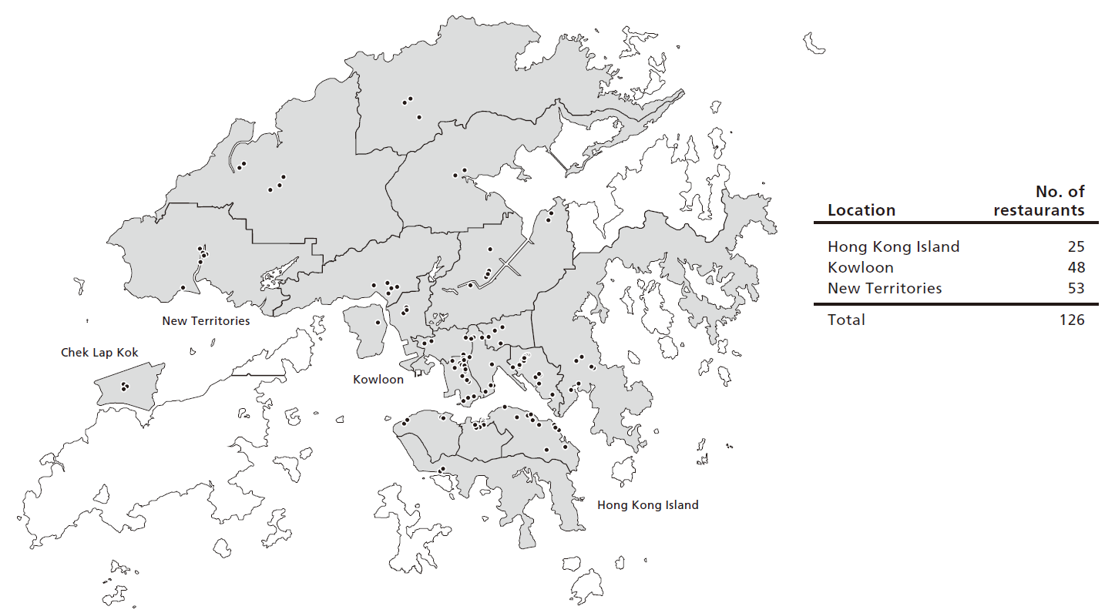
Geography of Restaurants
Business Aperture

Slide 20
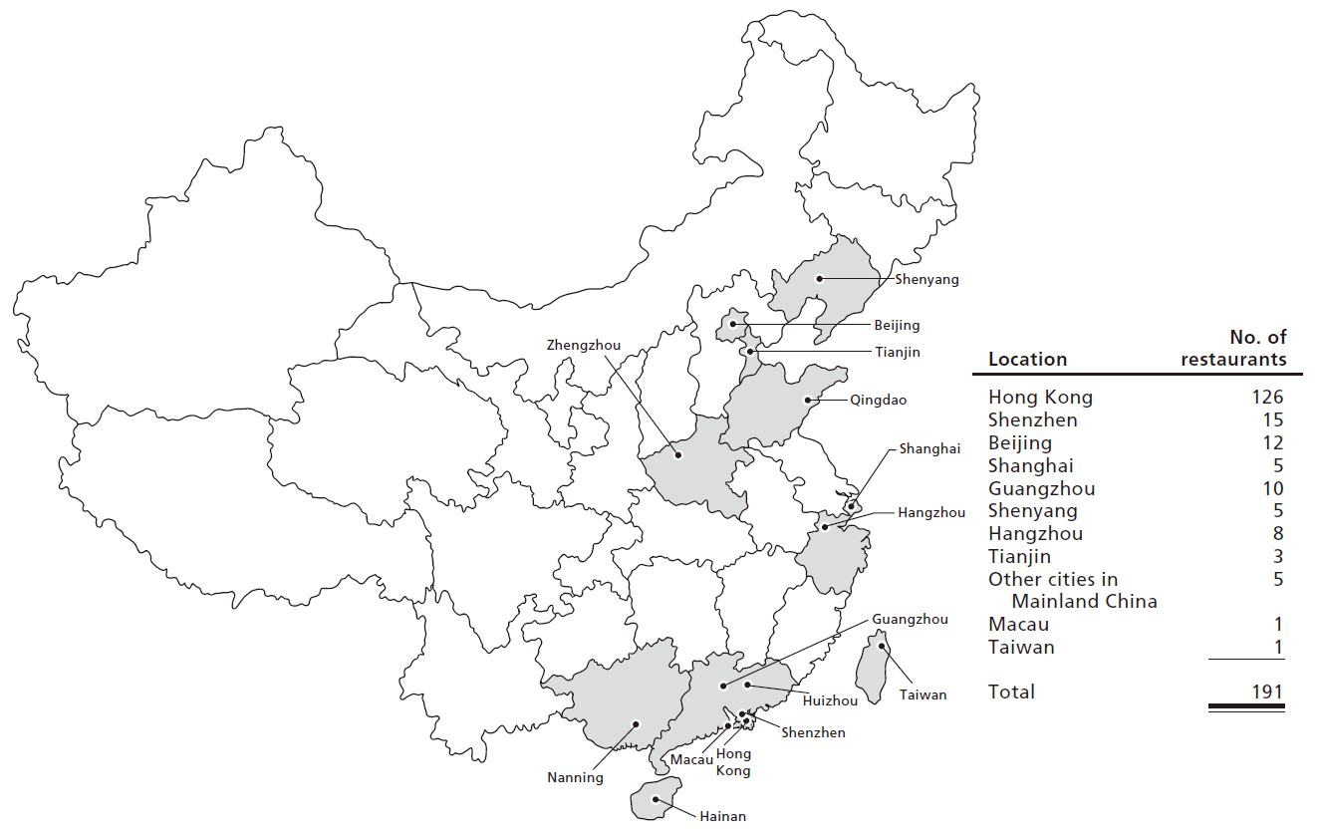
Geography of Restaurants
Business Aperture

Slide 21
Threats
Business Aperture
Increasing costs in Hong Kong
Fierce competition among restaurants
Ever since the Statutory Minimum Wage came in effect in 2011, the amount of minimum wage has been reviewed for 3 times. Moreover, the rising cost of raw materials such as meat and vegetables due to inflation creates significant pressure for restaurant operators to maintain their businesses. It is forecasted that the food price index of major raw materials in Hong Kong would grow at a CAGR of approximately 3.5% from 2017 to 2022.
The average monthly salary of employees in casual dining market in Hong Kong increased from HK$10,000 in 2013 to HK$12,400 in 2017, representing a CAGR of 5.5%. The new statutory minimum wage of HK$37.5 will come into effect from May 2019. According to the Rating and Valuation Department of Hong Kong, the average monthly rents for retail premises in Hong Kong recorded a CAGR of approximately 0.2%.
Customers’ preferences are constantly evolving. There has been higher expectations from consumers in the overall dining experience. Therefore restaurants are required to take initiatives, namely promotional campaigns, refurbishment of decoration and innovation of menu offerings, in order to stand out. Those unable to adapt to changes in consumers tastes will be left out.
Increasing costs in China
According to the National Bureau of Statistics, In China, the average annual salary of Employees in Catering Service Market is expected to grow at 7.5%, up from the previous years of 7.1%. Fortunately, the Consumer Price Index of Food and Major Raw Materials is expected to remain stable and flat. The average monthly rents of shopping centers in the first - tier cities are forecasted to keep an upward trend of between 1 to 3%.

Slide 22






Awards
Business Aperture
Hong Kong Top Service Brand Ten Year Achievement Award in 2018
Top 10 Outstanding Service
Retail Brands in 2018
Market Leadership in Casual Dining Restaurant 2018/19
"Hong Kong Star Brand Award – Corporate Award"
Hong Kong Famous Brands by Asia Brand Development Association
My Favourite Classic Brand Award by U Magazine

Slide 23
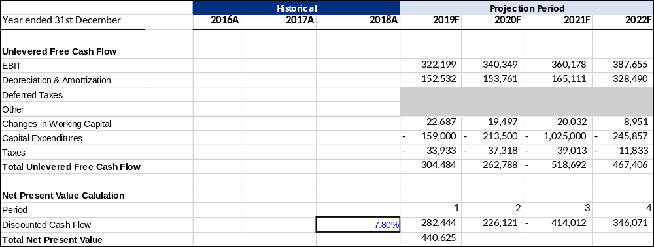
Valuation Analysis
Business Aperture

Slide 24
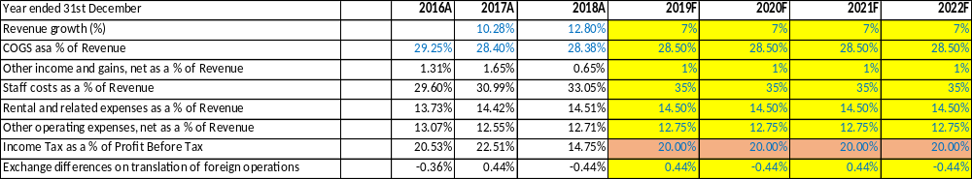
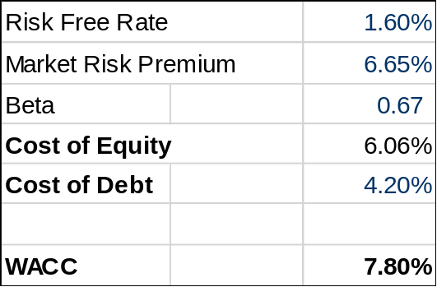
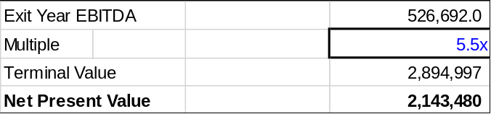
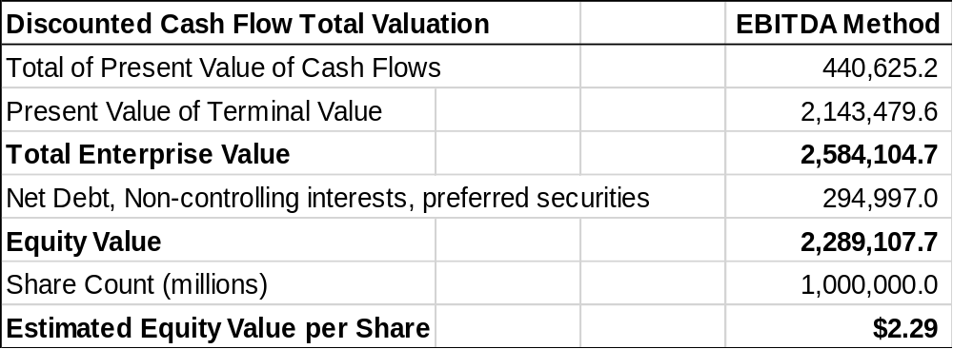
Valuation Analysis
Business Aperture
Operating Assumptions
Cost of Capital
Terminal Value
Discounted Cash Flow

