Slide 1

Business Aperture
DouYu International Holdings
Chinese version of Twitch looks to take a bite
NASDAQ:DOYU
Technology / Application Software
Price: $11.5 USD
Personal Advice:
Be careful, this fish might bite and leave a mark.
Date 18th July 2019

Slide 2
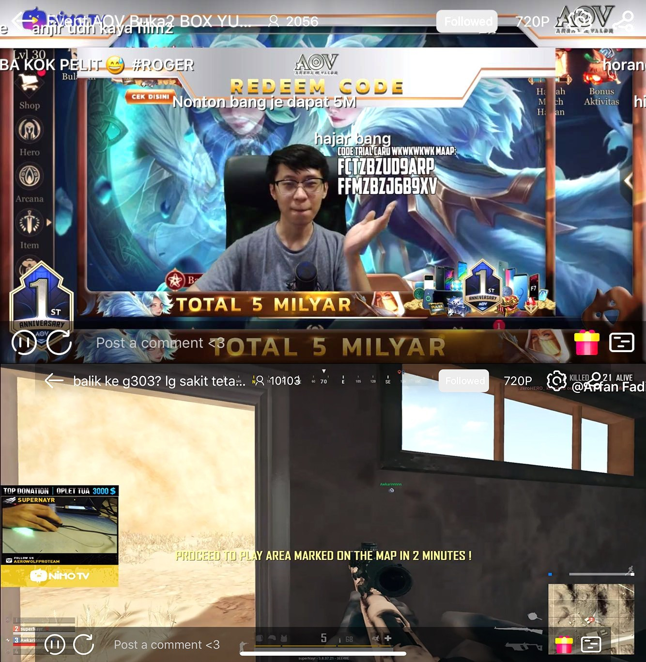
Company Overview
Business Aperture
Background
DoYou is a Game-centric live streaming platform in China, similar to Twitch in the US. They operate their platform on both PC and mobile apps. They ranked first based on average total MAUs, level of user engagement as measured by average total daily time spent by active users and number of top 100 game streamers.
Some Statistics
They had 159.2 million average total MAUs during the first quarter of 2019, representing year-over-year growth of 25.7% from 126.7 million average total MAUs during the same period of 2018.
They are also the most searched game-centric live streaming platform in China based on average of Baidu's search index as well as the top free and top grossing game-centric live streaming app in Apple's App Store in 2018.

Slide 3
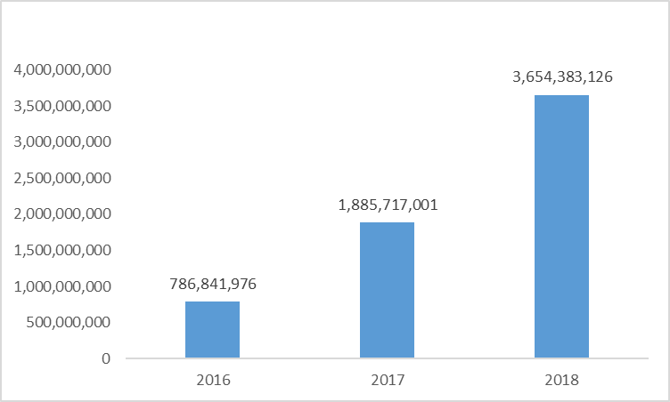
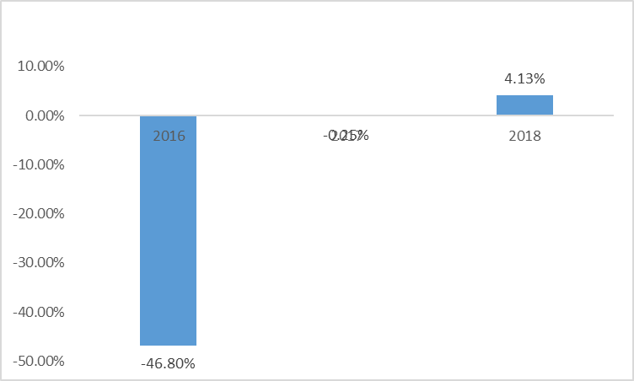
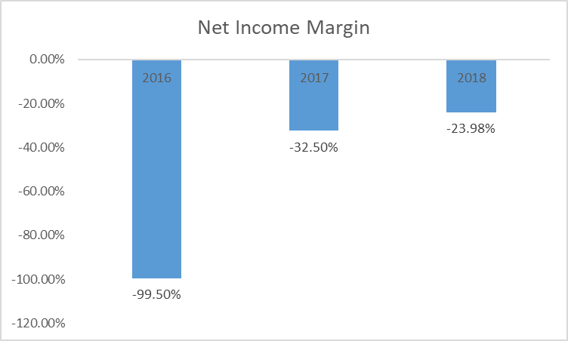
Selected Financial Metrics
Business Aperture
Net Revenues
Gross Margins
EBITDA Margins
Net Income Margins

Slide 4
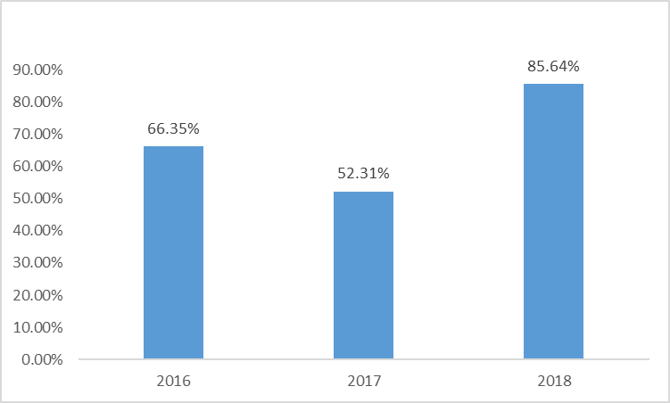
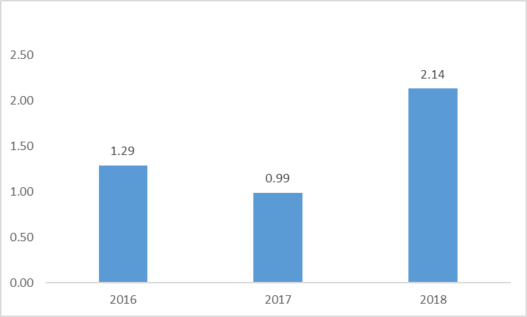
Selected Financial Metrics
Business Aperture
Cash as a % of Total Assets
Current Ratio
The company has a strong cash balance. This allows DoYou to invest heavily into technology and marketing when the opportunity arises. The company also has an asset light model, with little PP&E.
A majority of DoYou’s Current Liabilities are from its accounts payables. With a strong current ratio, the company is highly liquid. The firm also has no Debt and investors does not have to worry about insolvency.

Slide 5

Business Model
Business Aperture
Large amount of time spent on platform
Average total daily time spent by active users of 17.3 million and 26.0 million hours in the first quarter of 2018 and 2019, respectively. he average daily time spent by each active user was 42 minutes and 56 minutes for the same periods. This time spent on the platform can be Monetized.
Monetization Model not based on Ads
DouYu employs a multi-channel monetization model which primarily includes live streaming and advertisements, with live streaming being the main monetization channel generating 90.9% of total revenue in 2018. This live streaming revenue is primarily derived from the sales of a wide array of virtual gifts. In addition, the firm generates revenue from game distribution.

Slide 6

Strengths
Business Aperture
Leading player in China
According to iResearch, DoYou is the largest game centric live streaming platform measured by average total MAUs and average total daily time spent by active users in the first quarter of 2018 and 2019. The huge number of users and streamers is of huge commercial value to advertisers, game developers and publishers and in turn allow streamers to create more attractive content. This large and interactive community fuels a self-reinforcing network effect that helps solidify their leadership position

Slide 7
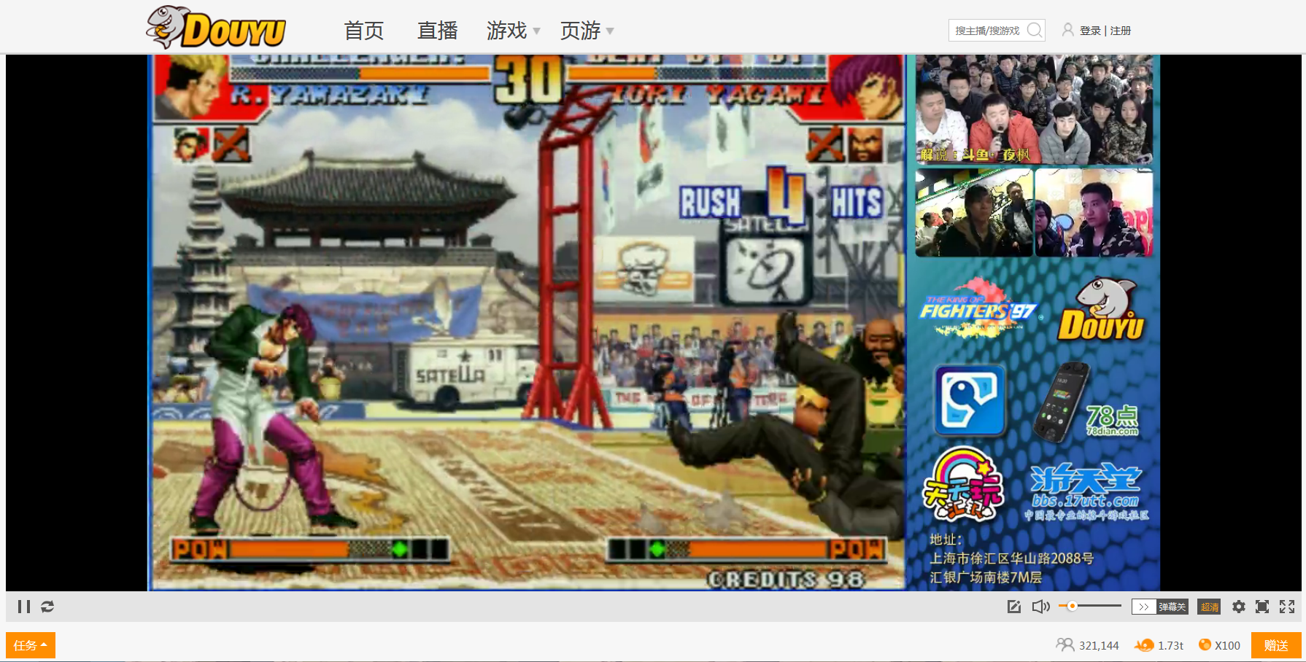
Strengths
Business Aperture
High retention rate = “Web Stickiness”
Diverse product offerings and continuously enriched content allow us to effectively retain users. For the past twelve months ended March 2019, the average next-month active user retention rate was 76.0%, as compared to 75.5% for the past twelve months ended March 2018. Based on their data, active users spend an average of 5.9 hrs/mth during their first quarter of accessing the platform, 13.9 hrs/mth in the fourth quarter from the quarter when they first accessed our platform and 16.2 hrs/mth in the sixth quarter.

Slide 8
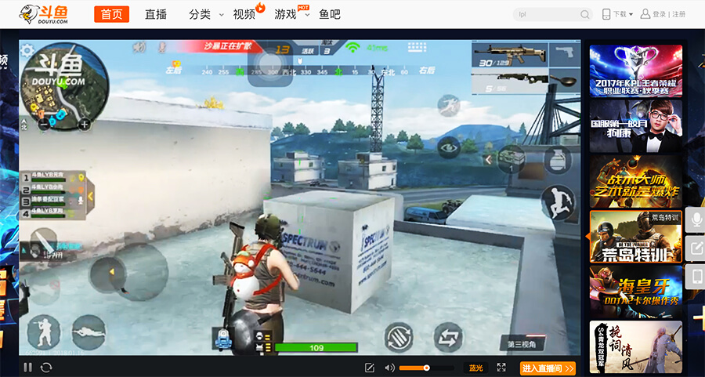
Strengths
Business Aperture
Strong presence of established streamers
According to iResearch, DoYou contracted with 51 out of 100 of China’s top 100 game streamers. DoYou signs exclusive contracts with both top individual streamers and streamer talent agencies that manage a large group of promising, rising streamers. This model ensures the stability of top streamers and their production of high quality streaming content. This also forces web stickiness as streamers cannot jump into other sites, similar to how Twitch is preventing user to jump into YouTube Gaming.
Exclusive streamers are useful as generated 65% and 66% of the total viewing time across DoYou’s platform.

Slide 9
Their Greatest Asset: Their Streamers
Business Aperture
The Important social icons
Streamer Discovery and Development
Being a new social phenomenon in China, streamers are like key opinion leaders or social icons who have gained wide popularity among the younger generation. DoYou serves as the platform to facilitate the monetization of this new social phenomenon.
DoYou identifies streamers with potential with whom they seek to sign exclusive contracts. They use a comprehensive performance metric analytical system which measures the quality of a streamer's content, activity levels and user engagement. These streamers with potential are given development plans which aims to guide the streamers to focus on trendy topics and increase their positive public exposure. For example, they are placed into different categories according to the demographics that they likely appeal to. DoYou then helps direct traffic from their target demographics to them by giving them top positions of streaming rooms. In fact, DoYou promote streamers' content on and outside of their platform, boost their popularity through traditional media channels and provide them with opportunities to attend online and offline activities where they can further increase their public exposure, such as Douyu Carnival.
Importance of Exclusive Streamers
Exclusive streamers contributed 65.8% to total viewership in terms of viewing hours on our platform and 61.2% of the total live streaming revenue generated from our platform. Exclusive streamers have exclusivity clauses, locking them in over 3-5 years. They are also given base salaries which alleviates streamers worries, allowing them to focus on creating quality content. Overtime, streamers stay on the channel due to its size and popularity.

Slide 10
Their Greatest Asset: Their Streamers
Business Aperture
Managing the content creators
Tailored content drives customer loyalty
The platform brings together a deep pool of top streamers and provides a sustainable streamer development system. 6,500 top streamers, each of whom entered into an exclusive contract with the firm.
Approximately 491,000 of their streamers are managed through talent agencies as of March 31, 2019. Their exclusive contract model with top streamers helps ensure a consistent supply of quality content, which is effectively supplemented by the talent agency model that captures a large group of promising and rising streamers.
With years of experience, they have developed a well-designed system to discover, train, and promote streamers who are already popular or have demonstrated the potential to become popular, and to help them grow and monetize their popularity.
They have built powerful technology infrastructure to help ensure a stable and optimized live streaming experience for our users. The optimized user experience attracts a large number of users on the platform and enables the to collect and analyze vast amounts of behavioral data leveraging their big data analytics capabilities. Investing in the user experience generates significant benefits for our platform.
For example, since the implementation of the customized content recommendation system in early 2016, the user click-through rate for content recommendations on the main page increased from 18% in June 2016 to 49% in March 2019. Through comprehensive and refined content categorization, customized recommendations and development of new products and features, they have enhance user experience to attract new users and increase user loyalty.

Slide 11

Their Greatest Asset: Their Streamers
Business Aperture
Strong Training Program
They have established a comprehensive streamer development system to discover, train, and promote our streamers. They talent scouting program aims to discover talented streamers at an early stage. This program is based on a well-designed streamer performance monitoring system, which uses more than 20 quantitative metrics generated from our proprietary user data analytics. After discovery and signing, they invest significant resources to incubate and train our exclusive streamers to improve their live streaming techniques and develop their personal styles to help grow their viewer base. In addition, they aim to increase streamers' influence beyond live streaming by offering them additional online and offline commercial opportunities.

Slide 12
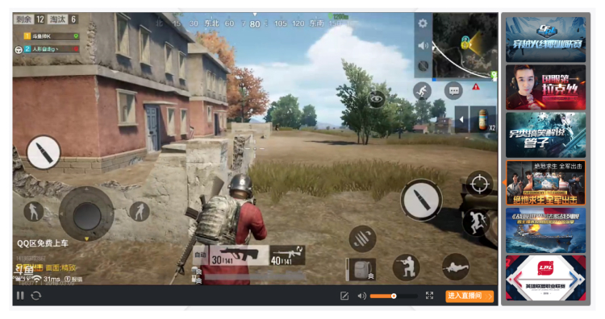
Other Notable Strengths
Business Aperture
Large Target Audience
Exclusive Rights
Strong diversity of games to include everyone. There are more than 300 game-themed channels on the platform, whereby the platform streamed 94 out of the top 100 games ranked based on Baidu's search index.
Since 2016, they have obtained global and nationwide exclusive streaming rights to 29 major tournaments in China, covering major games including League of Legends, PlayerUnknown's Battlegrounds, and DOTA2. It is no surprise then, that League of Legends, PlayerUnknown's Battlegrounds and King of Glory, are the three most popular eSports games on the platform.
Sponsorship create premium content
DouYu sponsors 26 teams specializing in League of Legends, PlayerUnknown's Battlegrounds or King of Glory in 2018. This gives DouYu access to premium quality eSports content, including training videos and play-throughs by leading eSports teams. In addition, former professional players stream on the site, generating premium quality eSports content.

Slide 13
Other Notable Strengths
Business Aperture
A tech company at heart
Services sector
DoYou focuses on technological advancement to provide better user experience. With their video stream scheduling capability, multi-dimensional CDN technology, and best-in-class low latency P2P technology that can process high volume of data with minimal delay (latency), they provide stable high-resolution viewing experience to viewers while minimizing bandwidth cost. This is all to offer superior live streaming experience.
DoYou also leverages on big data analytical capabilities. By leveraging their large viewer base and collecting and analysing cast amounts of behavioural data, DoYou is able to gain unique viewer insights and recommend customized content to them. Since the implementation of customized recommendation, viewer click-through rate for content recommendations on our home page increased from 18% in June 2016 to 49% in March 2019.
Multiple monetization channels
Using AI to place advertisements
Live streaming is DoYou’s, main monetization channel, accounting of 90% of total revenue in 2018. This is mainly done through sales of virtual gifts. This is driven by promoting popular streamers, soliciting content compelling to specific users and encouraging the gifting. DoYou incentivize user spending by offering customized virtual gifts and various streamer and user rankings on the platform.
Their technologies also help enhance our value proposition to advertisers and eSports partners. Through big data analytics, they can identify the most effective way of promoting products, and help game developers and publishers to better target traffic on the platform. Their smart scenario advertising service captures and analyzes real-time live streaming content using AI image detection technology and place integrated interactive advertisements accordingly.

Slide 14
DoYou’s core competitive games
Business Aperture
Multiplayer Online Battle Arena (MOBA)
Sports/Racing
League of Legends
King of Glory
DOTA 2
NBA2K
Rocket League
FIFA 4
First Person Shooter
Real Time Strategy (RTS) & Fighting
PlayerUnknown’s Battlegrounds
CS: GO
Cross Fire
Fortnite
Overwatch
Starcraft 2
Warcraft 3
Dungeon Fighter
Street Fighters

Slide 15
Industry
Business Aperture
Strong Market Profile
Huge video streaming market in China
According to iResearch, China is the world's largest game-centric live streaming market, with approximately 4.9 times the MAUs of the U.S. market in 2018.
Huge Growth is expected to continue
With revenues from China's game-centric live streaming market is expected to grow at a CAGR of 24.7% from 2018 to 2023, which is nearly twice the expected growth rate of the non-game-centric live streaming market.
Game centred streaming slowly taking a larger portion
Game-centric live streaming revenue accounted for 13.8%, 24.1% and 28.0% of total live streaming revenue in 2016, 2017 and 2018 in China.
Growing number of Users
The average total MAUs of game-centric live streaming platforms in China is expected to increase from 255 million in 2018 to 417 million by 2023. As the leading game-centric live streaming platform in China, we are well positioned to capture a significant share of this large and growing user base.

Slide 16
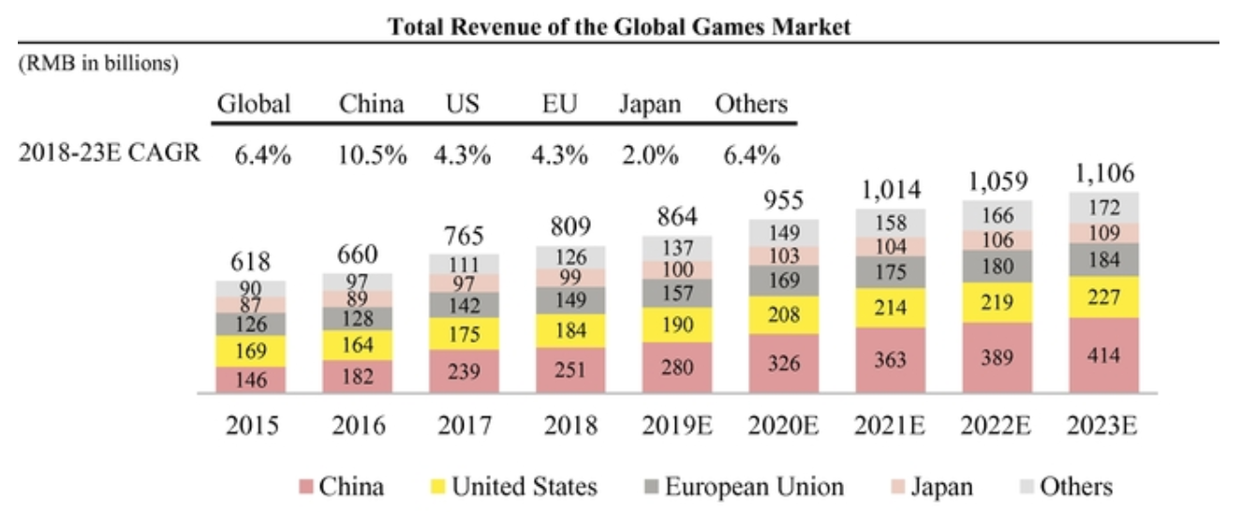
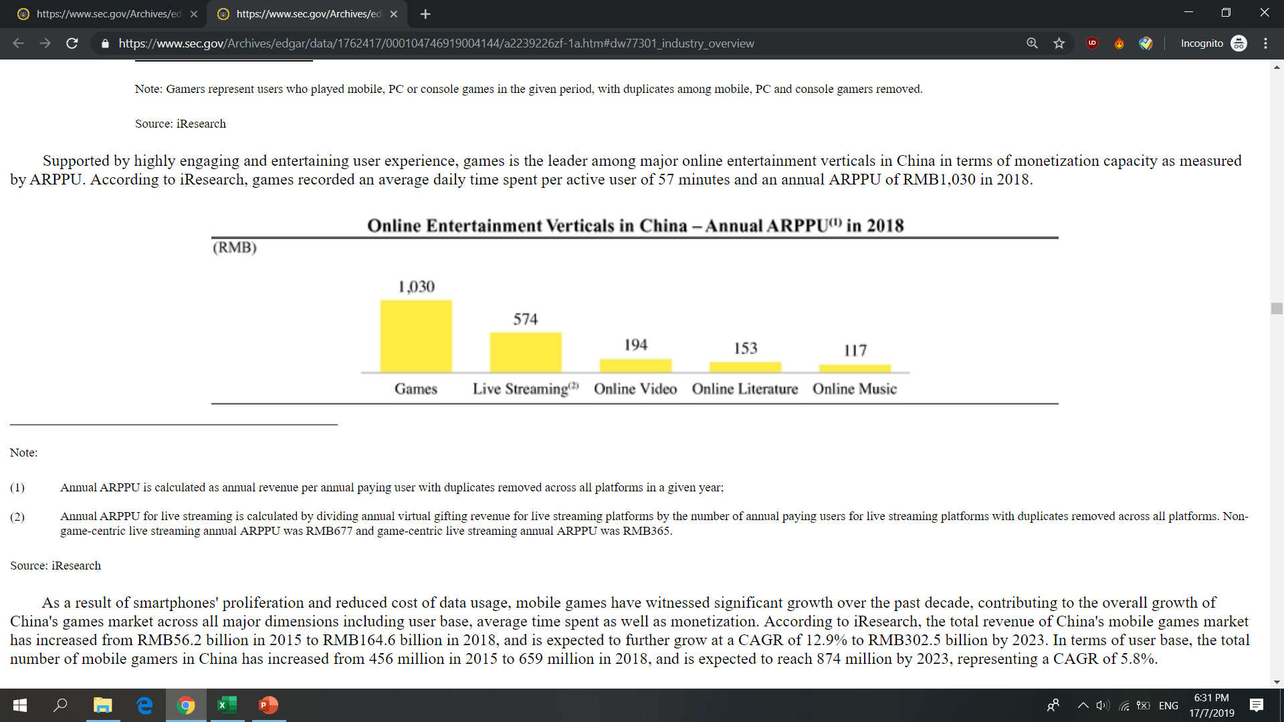
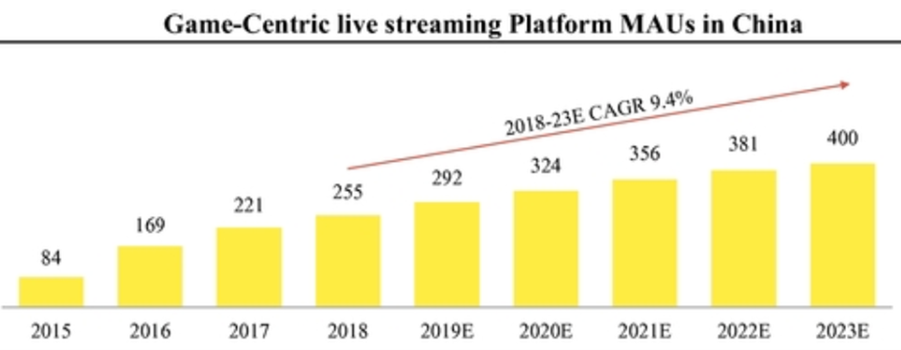
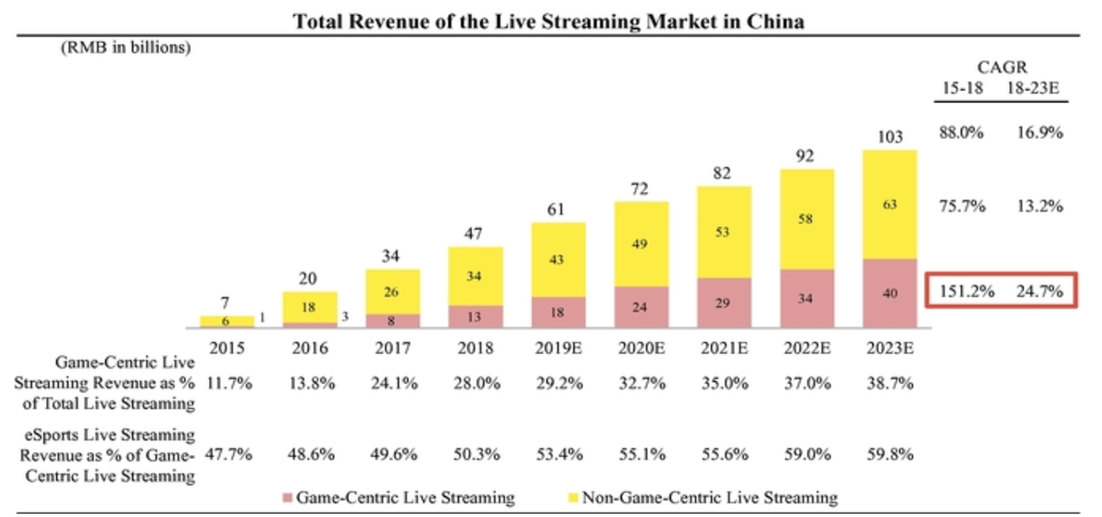
Industry
Business Aperture
China is the world leader in the Games Streaming Industry
Game related Streaming drives the most revenue
Increasing popularity in Game Streaming
Expected CAGR of 16.9% moving forward

Slide 17

Potential Risks
Business Aperture
Unprofitable Company
While DoYou is cash rich, they have been bleeding cash. The bulk of their costs come from their COGS, while includes paying their coders and their streamers. They also large amounts of money reaching customers and sponsoring events. Whether they can reach profitability is yet to be seen.
Shaky Business Model
Unlike traditional media, DoYou relies on less than 10% of Advertising for revenue. They heavily rely on users to fund their business. This can take a swift turn, in an economic downturn, if consumers prefer another platform & if another company gets an exclusive license on a new popular game.
Strong Competitors
Huya, one of its strongest competitors has positive EBIT margins and similar revenues to DoYou. The space is highly competitive and requires large amount of cash.

Slide 18

Valuation
Business Aperture
Comparable Analysis
Refer to Excel

Slide 19

Final Thoughts
Business Aperture
Strong growth prospects with Powerful Backer
DouYu is backed by Tencent, the Chinese Gaming Giant. This strategic cooperation entails Tencent creating the games while DouYu promotes them (earning revenue as well). Tencent would then provide DouYu with exclusive licenses to maximise profitability. These benefits can only be realized down the road.
On top of this, Tencent also backs DouYu’s competitor, Huya. The long term plan is to get the companies to collaborate, In an effort to reduce direct competition and to focus on their niche areas.
Lacklustre IPO
DouYu priced its stock at its lowest range, while having minimal activity during the IPO day, ending flat. I believe the sentiment for such a stock is waning, which can be seen from Huya’s stock price. Short term, I believe we should “SELL” the stock, and wait for more significant progress before entering a trade.

